Slide 1
Analyze Data Shape and Context
Math 6B Unit 8 Lesson 9

Slide 2
Key Words
center – measure that best describes a typical value in a dataset
interquartile range (IQR) – measure of variability of a dataset that is the difference between the first quartile and third quartile
mean – measure of center of a dataset that is the sum of the data divided by the number of data values
median – measure of center of a dataset that is the middle value when ordered from least to greatest
mode – measure of center of a dataset that is the value which appears most often
mean absolute deviation (MAD) – measure of variability of a dataset that is the average distance between each data point and the mean
range – measure of variability of a dataset that is the difference between the minimum and maximum values
variability – measure of how spread out the values of a dataset are •

Slide 3
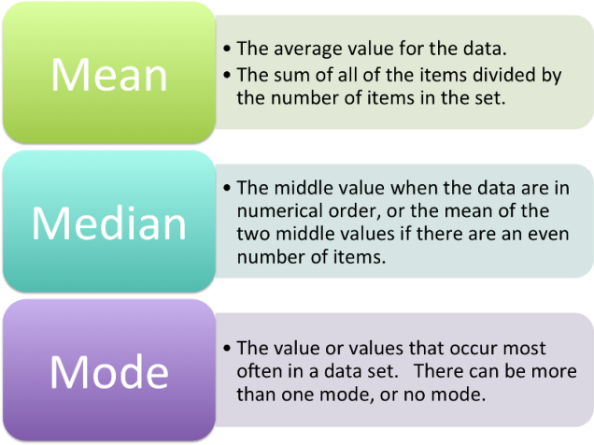
Measures of Center
Help us understand the 'average' value of a data set
Three common measures: mean, median, mode
Choice of measure depends on shape of data distribution
Notes:
When we summarize a data set, one of the things we want to know is what the 'average' value is. We use measures of center to do this. There are three common measures of center: mean, median, and mode. The choice of which measure to use depends on the shape of the data distribution.

Slide 4
Measures of Variability
Help us understand how spread out the data is
Three common measures: range, interquartile range (IQR), mean absolute deviation (MAD)
Choice of measure depends on context of data set

Slide 5
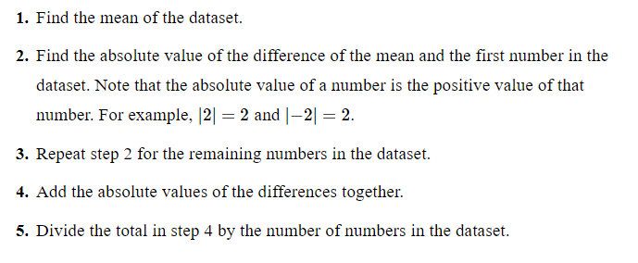
MAD of a Dataset Calculated

Slide 6
Putting It All Together
Use measures of center and variability to understand data sets
Consider the context in which the data was gathered
Make informed decisions based on the data

Slide 7
Real-World Examples of Summarizing Data Sets
Data analysis can help us make informed decisions in various fields such as finance, healthcare, and marketing
For example, in finance, analyzing stock prices can help investors make investment decisions
In healthcare, analyzing patient data can help doctors identify trends and patterns to provide better treatment
In marketing, analyzing customer data can help companies identify their target audience and create more effective marketing strategies
Notes:
In today's data-driven world, data analysis has become an essential tool in various fields. Summarizing numerical data sets can help us identify trends, patterns, and insights that can lead to better decision-making. In finance, analyzing stock prices can help investors make informed decisions about their investments. In healthcare, analyzing patient data can help doctors identify trends and patterns to provide better treatment. In marketing, analyzing customer data can help companies identify their target audience and create more effective marketing strategies.

Slide 8
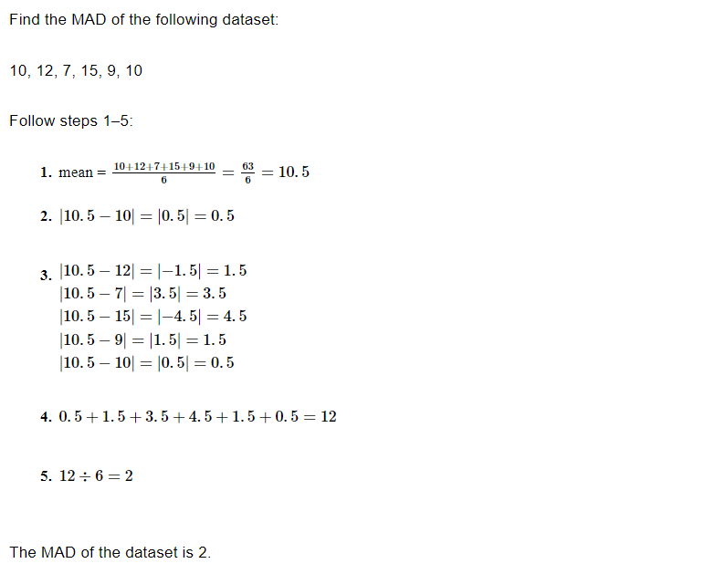
Example

Slide 9
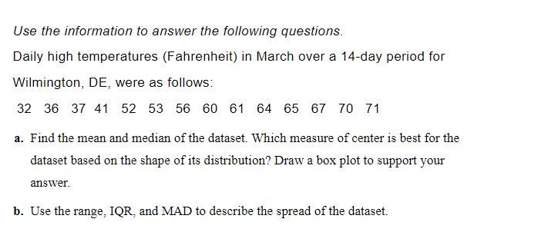
Practice

Slide 10
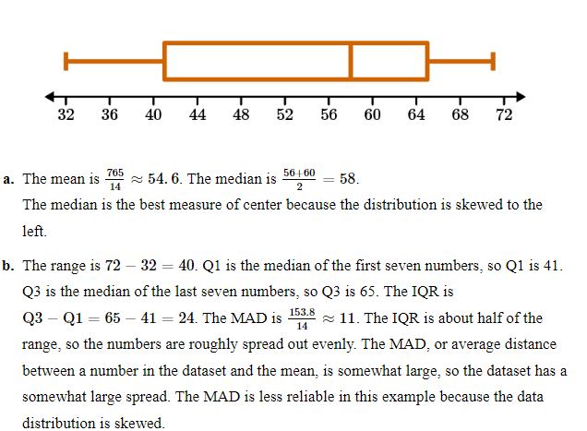
Answer

Slide 11
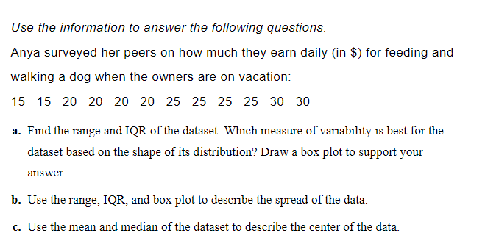
Practice

Slide 12
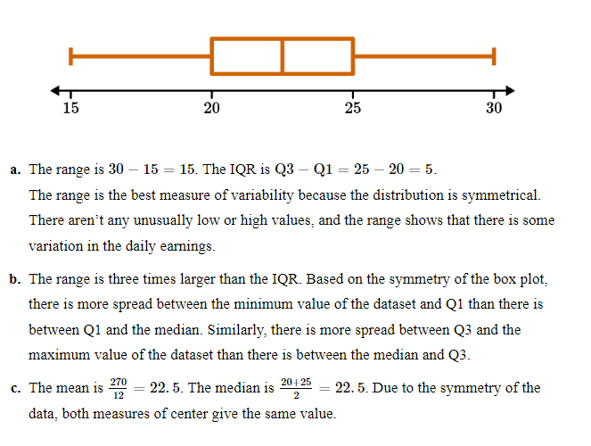
Answer

Slide 13
GeoGebra Practice
Calculating Mean Absolute Deviation (MAD): https://www.geogebra.org/m/zdkqapac
Calculate Mean Absolute Deviation (M.A.D): https://www.geogebra.org/m/UaMEvgyH
Investigating Data Using MAD: https://www.geogebra.org/m/actbqhcj

Slide 14
Summary
What is a data set and how can it be used to make informed decisions
Measures of center for understanding the 'average' value of a data set
Measures of variability for understanding how spread out the data is
How to use measures of center and variability to understand data sets
Real-world examples of analyzing data sets in finance, healthcare, and marketing

