Slide 1
Measures of Center
Math 6B Unit 8 Lesson 4
Notes:
Hello Students! Welcome to the world of data! Are you ready to learn how to find the mean and median of a data set? In this presentation, we will also be discussing the center of a numerical data set and how to determine whether the mean or median best describes the shape of a data set.

Slide 2
Key Words
data set – a collection of related information
mean – the sum of the data divided by the number of data values
measure of center – a measure that describes the typical value of a data set
median – the middle value of a set of data when ordered from least to greatest
skewed – when the values of the mean and the median are not equal or close to one another
symmetrical – when the values of the mean and the median are very close or equal to one another

Slide 3
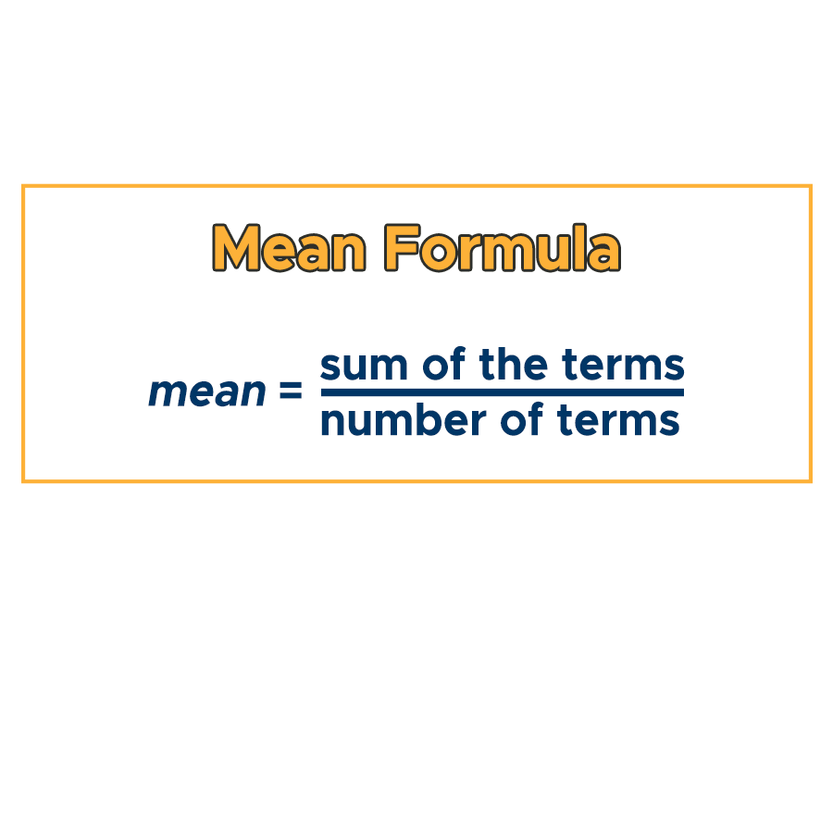
What is the Mean?
The mean is the average value in a data set.
To find the mean, add up all the values in the data set and divide by the number of values.
The mean is sensitive to extreme values in the data set.
Notes:
Let's start with the mean. The mean is the average value in a data set. To find the mean, add up all the values in the data set and divide by the number of values. The mean is sensitive to extreme values in the data set, which can greatly affect the overall value. For example, if we have a set of test scores and one student scores significantly higher or lower than the rest, it will greatly affect the mean score.

Slide 4
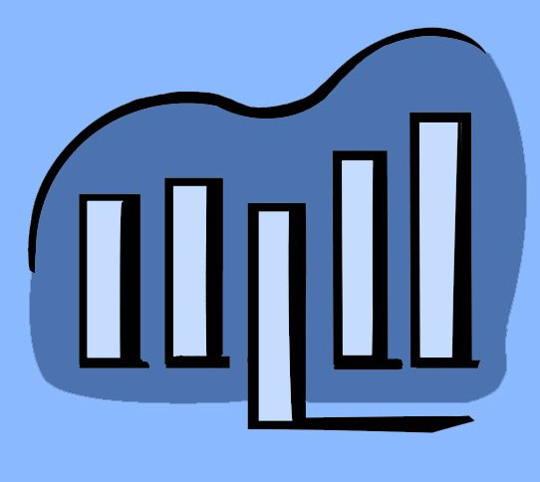
What is the Median?
The median is the middle value in a data set.
To find the median, arrange the values in order from least to greatest and find the middle value.
The median is not affected by extreme values in the data set.
Notes:
Now let's move on to the median. The median is the middle value in a data set. To find the median, we arrange the values in order from least to greatest and find the middle value. The median is not affected by extreme values in the data set, which makes it a good measure of center for data sets with extreme values. For example, if we have a set of salaries and one employee earns a significantly higher salary than the rest, it will not affect the median salary.

Slide 5

Which Measure of Center to Use?
To determine which measure of center to use, you should look at the shape of the data set.
The mean is best used when the data set is symmetrical and has no extreme values.
The median is best used when the data set is skewed or has extreme values.
Notes:
So, which measure of center should we use? The mean is best used when the data set is symmetrical and has no extreme values. The median is best used when the data set is skewed or has extreme values. To determine which measure of center to use, you should look at the shape of the data set. If it is symmetrical, use the mean. If it is skewed or has extreme values, use the median.

Slide 6
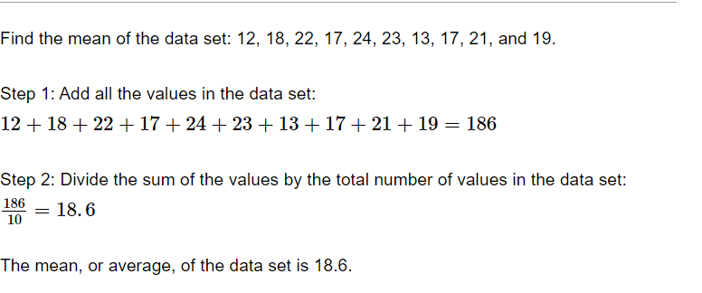
Example

Slide 7
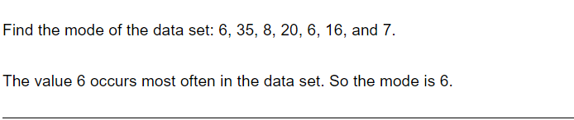
Example

Slide 8
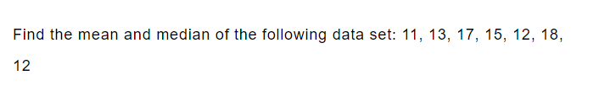
Practice

Slide 9

Answer

Slide 10
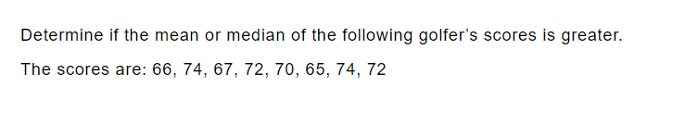
Practice

Slide 11
Answer

Slide 12
GeoGebra Practice
Visualizing the Measures of Center: https://www.geogebra.org/m/ubDsmPDh
Mean, Mode, Median, and Range: https://www.geogebra.org/m/ZJztkKaz
Visualize Measures of Center and Spread: https://www.geogebra.org/m/yjxeudru
Interpreting Measures of Center & Variability: https://www.geogebra.org/m/yd7aw2br
Measures of center: https://www.geogebra.org/m/hks2hwe5

Slide 13
Summary
Mean is the average value in a data set, Median is the middle value in a data set
Mean is sensitive to extreme values in the data set, Median is not affected by extreme values in the data set
Mean is best used when the data set is symmetrical and has no extreme values, Median is best used when the data set is skewed or has extreme values
Notes:
This presentation covered measures of center, including the Mean and Median. We learned that the Mean is the average value in a data set, and can be sensitive to extreme values, while the Median is the middle value and not affected by extreme values. We also learned that the best measure of center to use depends on the shape of the data set. Additionally, we covered key vocabulary terms related to measures of center.

