Slide 1
Compare Methods of Finding Volume
Math 6B Unit 6 Lesson 9
Notes:
In this presentation, we will learn how to multiply the edge lengths of a right rectangular prism with fractional edge lengths to show that the product is the same as the volume found by packing the prism with unit cubes of the appropriate unit fraction edge lengths.

Slide 2
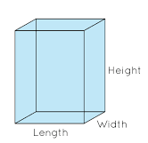
Key Words
right rectangular prism – a three-dimensional figure with 6 rectangular faces, 12 edges, and 8 vertices
volume – the amount of space inside of a three-dimensional figure

Slide 3
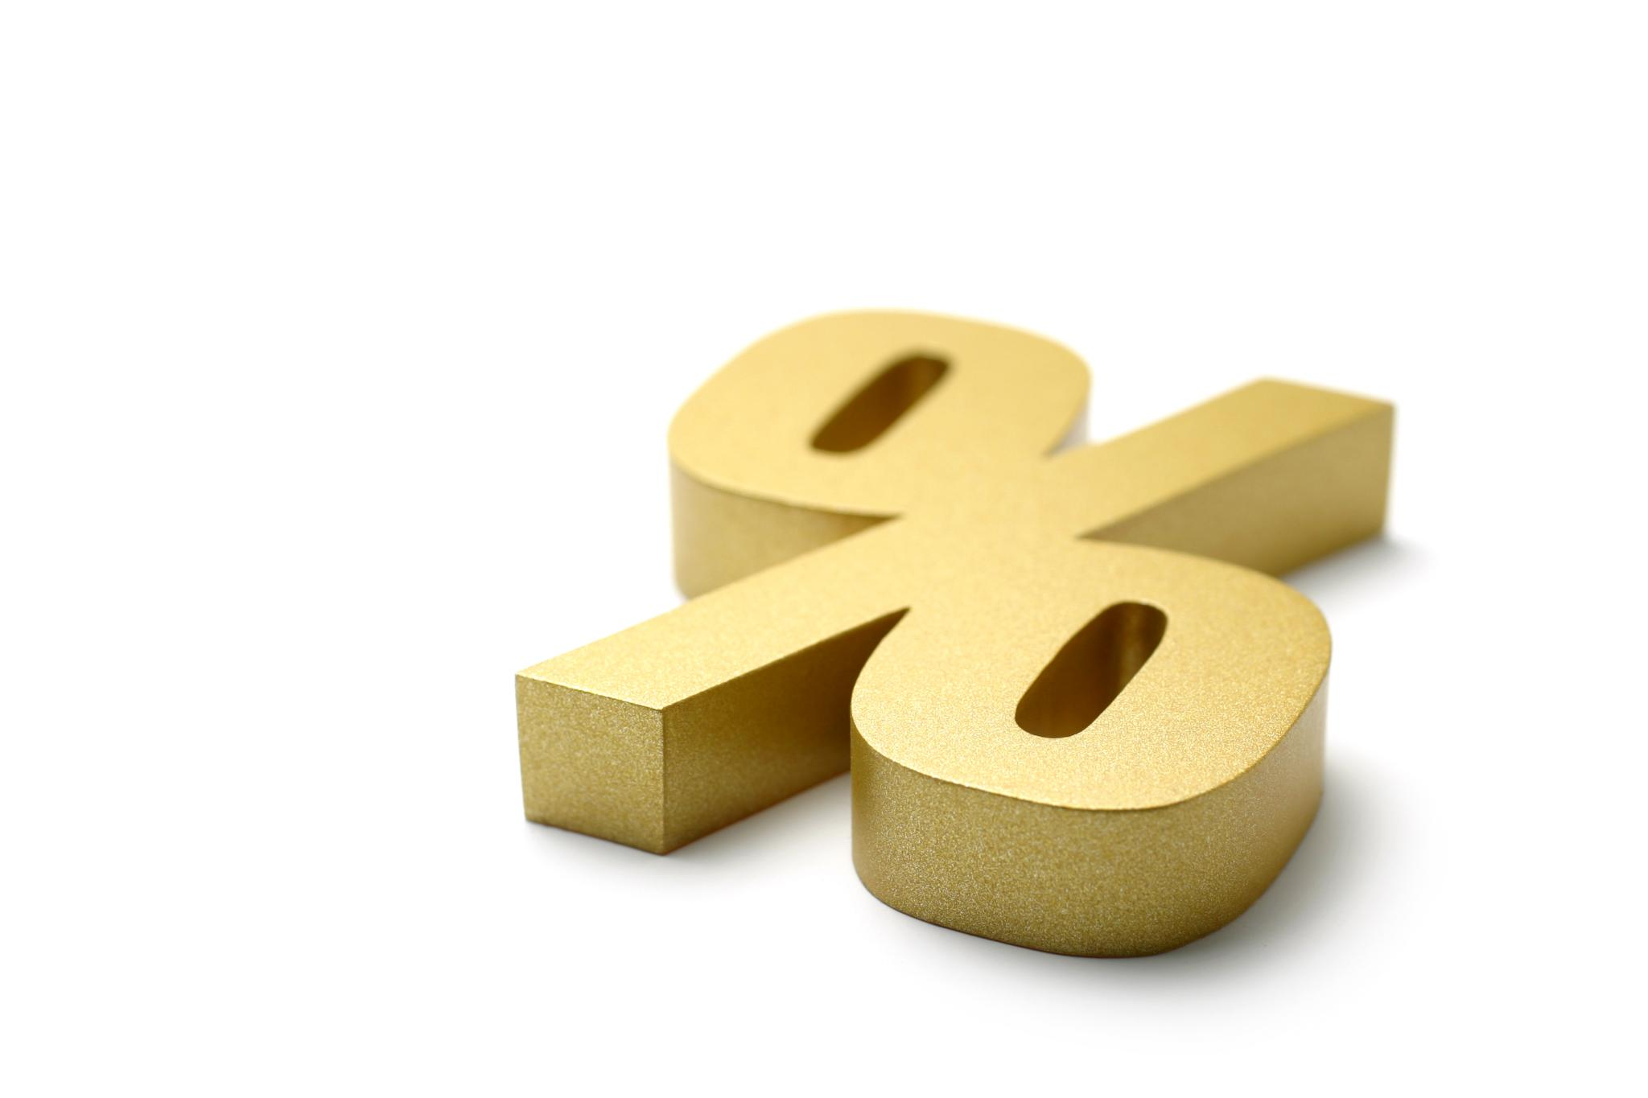
What are Fractional Edge Lengths?
Fractional edge lengths are the lengths of the edges of a right rectangular prism expressed in fractions.
The numerator of each fraction represents the length of the edge and the denominator represents the unit fraction length.
For example, if the edge length of a rectangular prism is 2/3, it means that 2 unit fractions of length 1/3 make up the edge.
Notes:
Now that we know what a right rectangular prism is, let's move on to fractional edge lengths and how they are expressed.

Slide 4
Multiplying Edge Lengths to Find Volume
To find the volume of a right rectangular prism with fractional edge lengths, we need to multiply its three edge lengths.
For example, if the edge lengths of a rectangular prism are 1/2, 2/3, and 3/4, its volume is (1/2) x (2/3) x (3/4) = 1/4.
We can then pack the prism with 1/8 unit cubes to verify that its volume is indeed 1/4 cubic units.
Notes:
Now that we understand how to find the volume of a right rectangular prism with fractional edge lengths, let's practice with some examples.

Slide 5
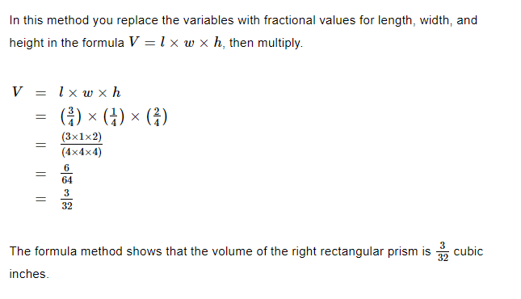
Example

Slide 6
Practice Examples
Example 1: A rectangular prism has edge lengths of 1/3, 2/3, and 3/4. What is its volume?
Example 2: A rectangular prism has edge lengths of 1/2, 1/4, and 1/8. What is its volume?
Notes:
Let's put what we learned into practice with some examples.

Slide 7
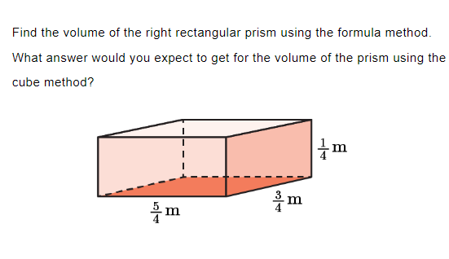
Practice the Formula Method

Slide 8
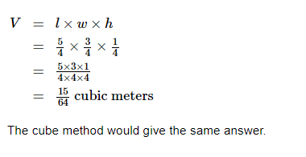
Answer

Slide 9
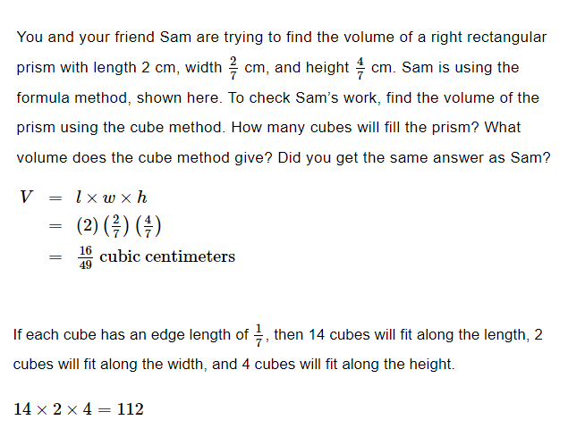
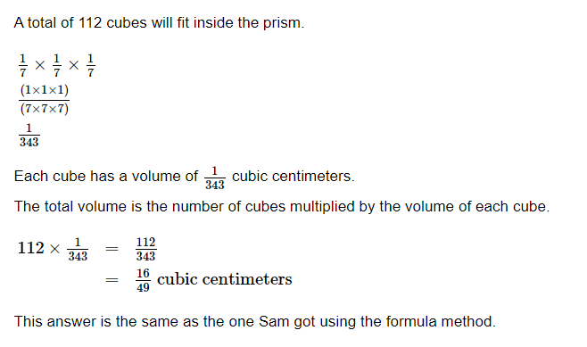
Practice the Cube Method

