Slide 1
Solving One-Step Inequalities Involving Addition or Subtraction
Math 6B Unit 5; Lesson 5
Notes:
Welcome! Today we will learn how to solve one-step inequalities involving addition or subtraction. Inequalities are mathematical expressions that show the relationship between two quantities, where one quantity is greater than or less than the other. An inequality is solved by finding the value that makes the inequality true. Let's get started!

Slide 2
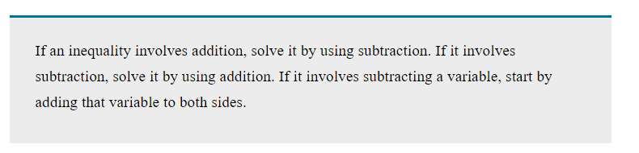
Adding and Subtracting
Add or subtract the same number from both sides of the inequality
The inequality symbol remains the same
Notes:
To solve an inequality involving addition or subtraction, we add or subtract the same number from both sides of the inequality. This keeps the inequality true and we can find the value of the variable. Remember, the inequality symbol remains the same. Let's look at some examples.

Slide 3
Example 1
5 + x > 9
Subtract 5 from both sides
x > 4
Notes:
Let's solve this inequality: 5 + x > 9. Subtract 5 from both sides to isolate the variable. We get x > 4. The solution to this inequality is all values of x that are greater than 4. Great job!

Slide 4
Example 2
12 - y < 8
Subtract 12 from both sides
-y < -4
Divide by -1
y > 4
Notes:
Let's solve this inequality: 12 - y < 8. Subtract 12 from both sides to isolate the variable. We get -y < -4. We need to divide both sides by -1, but remember that when we divide by a negative number, we need to flip the inequality. We get y > 4. The solution to this inequality is all values of y that are greater than 4. Keep up the good work!

Slide 5
Practice Time!
Solve
Solve the given inequalities
Check
Check your answer
Use
Use the previous examples as a guide
Notes:
It's practice time! Solve the following inequalities and check your answer. Use the previous examples as a guide.
1. 3 + x < 8
2. 15 - y > 9
3. 2z + 7 > 13
Great job! You've learned how to solve one-step inequalities involving addition or subtraction!

Slide 6
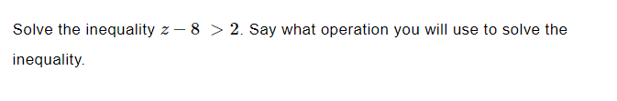
Practice

Slide 7
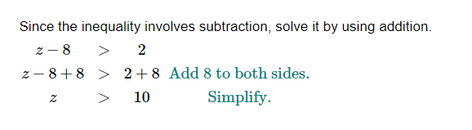
Answer

Slide 8

Practice

Slide 9
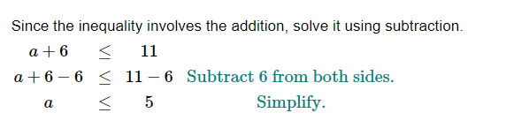
Answer

Slide 10
Real-World Problem Solving
Inequalities show relationship between two quantities
Solve inequality by finding value that makes it true
Add or subtract same number from both sides
Notes:
We use inequalities to represent math relationships between two things, such as cost and quantity. Solving inequalities helps us understand how to find a solution that works for both things.

Slide 11

Adding and Subtracting
Add or subtract the same number from both sides of the inequality
Inequality symbol remains the same
Notes:
To solve an inequality involving addition or subtraction, we need to add or subtract the same number from both sides of the inequality. This helps maintain the relationship between the two things we're comparing.

Slide 12

Example 1
5 + x > 9
Subtract 5 from both sides
x > 4
Notes:
Let's solve an example problem. If 5 plus a number is greater than 9, what is that number? First, we subtract 5 from both sides of the inequality. This gives us x > 4, which means that the number we're looking for is greater than 4.

Slide 13

Example 2
12 - y < 8
Subtract 12 from both sides
-y < -4
Divide by -1
y > 4
Notes:
Let's try another example. If 12 minus a number is less than 8, what is that number? First, we subtract 12 from both sides of the inequality. This gives us -y < -4. Since this is a negative inequality, we need to divide both sides by -1 to switch the inequality symbol. This gives us y > 4, which means that the number we're looking for is greater than 4.

Slide 14
Practice Time!
Solve
Solve the given inequalities
Check
Check your answer
Use
Use the previous examples as a guide
Notes:
Now it's practice time! Try solving the given inequalities and check your answer. Use the previous examples as a guide to help you solve the problems.

Slide 15
Practice
2 + a > 7
Subtract 2 from both sides
a > 5
Notes:
Here's your first practice problem. If 2 plus a number is greater than 7, what is that number? Remember to subtract 2 from both sides of the inequality to solve for a.

Slide 16

Answer
a > 5
Notes:
The answer is a > 5. Great job!

Slide 17
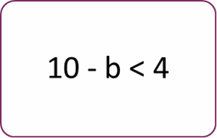
Practice
Subtract 10 from both sides
-b < -6
Divide by -1
b > 6
Notes:
Here's another practice problem. If 10 minus a number is less than 4, what is that number? Remember to divide both sides of the inequality by -1 to switch the inequality symbol, since this is a negative inequality.

Slide 18
Answer
b > 6
Notes:
The answer is b > 6. Well done!

Slide 19
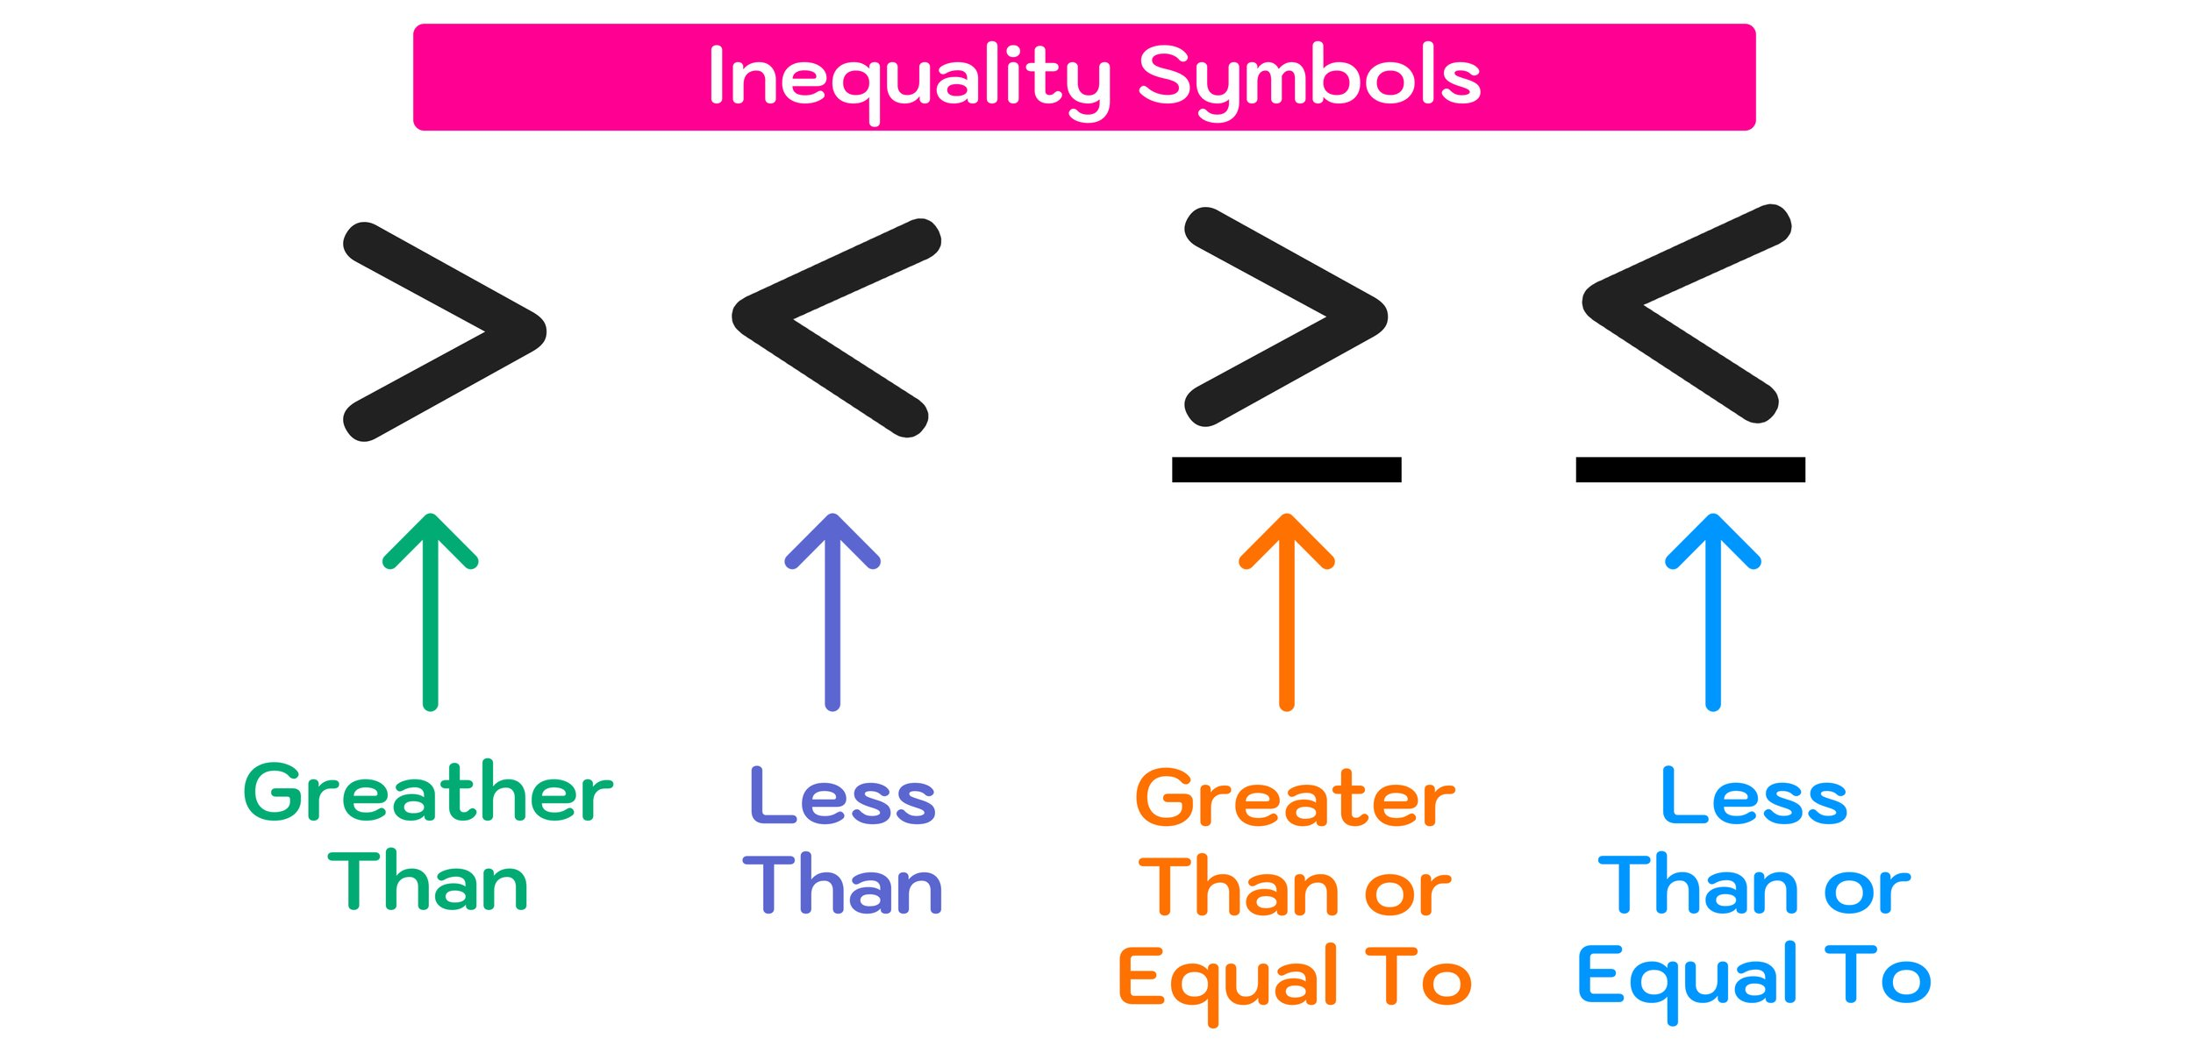
Recap
Inequalities show relationship between two quantities
Add or subtract the same number from both sides
Check your answer
Notes:
We've learned how to solve real-world problems by writing inequalities involving addition or subtraction. Remember to check your answer and make sure it makes sense in the context of the problem. Great work!

