Slide 1
Measures of Variation
Math 6B Unit 8 Lesson 5

Slide 2
Key Words
extreme – the largest and smallest values in a dataset
first quartile – the value in a dataset when 25% of the data is less than that value, when ordered from least to greatest
maximum – the largest value in a dataset
median – the middle value of a set of data when ordered from least to greatest minimum – the smallest value in a dataset
third quartile – the value in a dataset of which 75% of the data is less than that value, when ordered from least to greatest

Slide 3
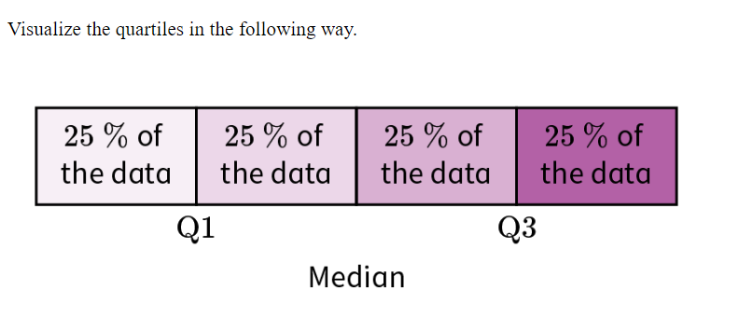
Quartiles and Extremes
Quartiles divide a data set into quarters.
The first quartile (Q1) is the median of the lower half of the data set.
The second quartile (Q2) is the median of the entire data set.
The third quartile (Q3) is the median of the upper half of the data set.
The range is the difference between the maximum and minimum values of a data set.
The extremes are the minimum and maximum values of a data set.

Slide 4

Calculating Quartiles and Extremes
Arrange the data set in order from smallest to largest.
Find the median of the entire data set to get Q2.
Find the median of the lower half of the data set to get Q1.
Find the median of the upper half of the data set to get Q3.
The range is the difference between the maximum and minimum values of the data set.
The extremes are the minimum and maximum values of the data set.

Slide 5
Interquartile Range
The interquartile range (IQR) is the difference between Q3 and Q1.
The IQR tells us how spread out the middle 50% of the data set is.
The IQR is useful for identifying outliers in a data set.

Slide 6
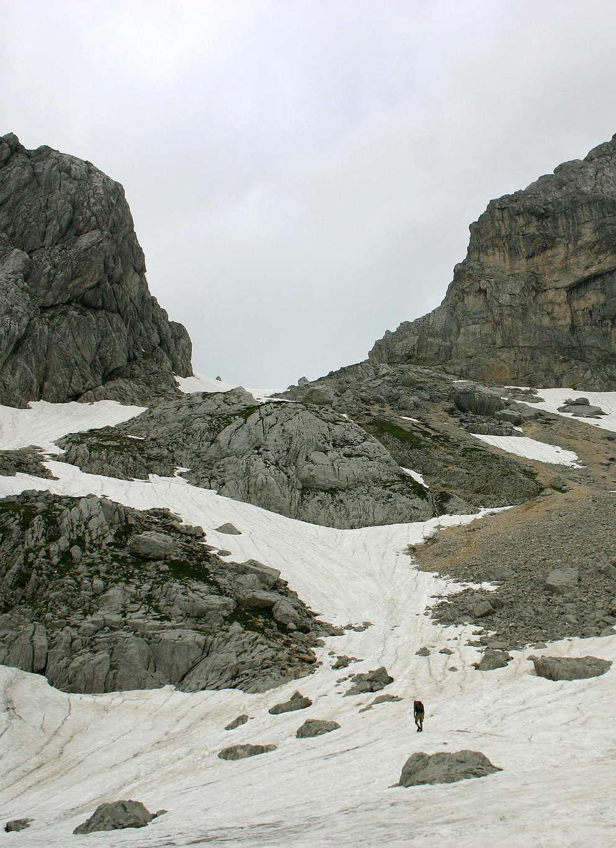
Calculating Interquartile Range
Calculate Q3 and Q1 as before.
Subtract Q1 from Q3 to get the IQR.

Slide 7
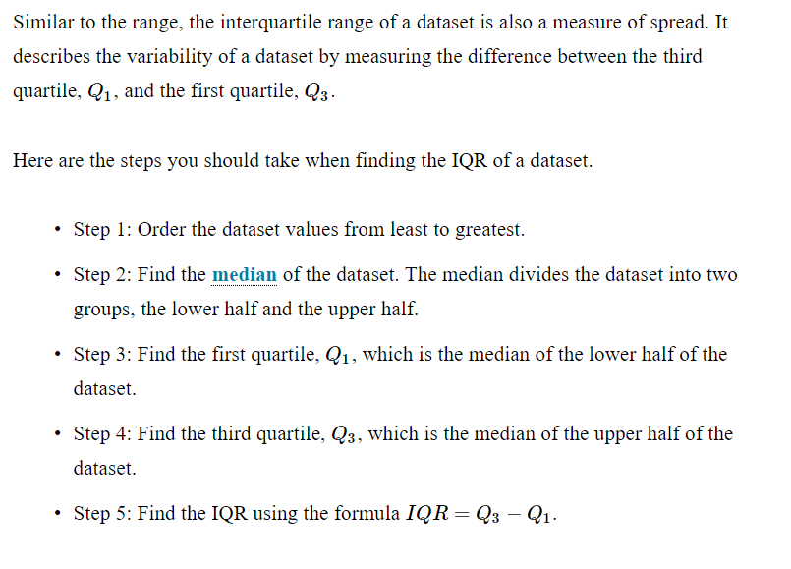

Slide 8

Real World Examples of Identifying Quartiles in Data
Identifying employee salary quartiles in a company to determine salary distribution
Analyzing student test scores to determine the distribution of grades within a class
Examining customer purchase history to determine the frequency of purchases and identify loyal customers
Assessing the distribution of car prices in a dealership to inform pricing strategies

Slide 9
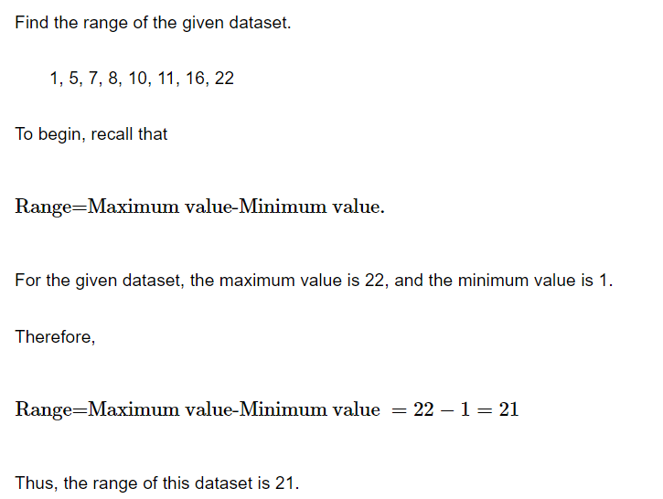
Example

Slide 10
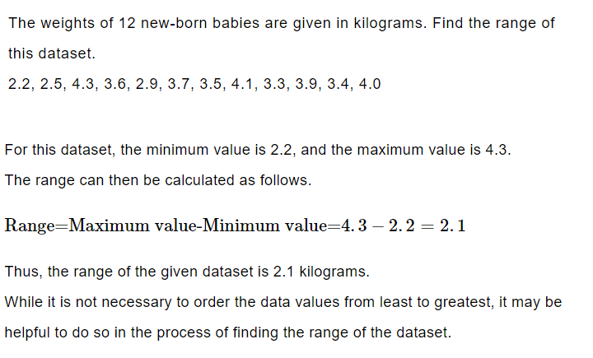
Example

Slide 11
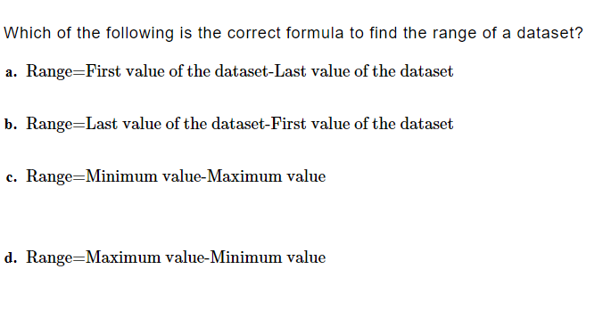
Practice

Slide 12

Answer

Slide 13
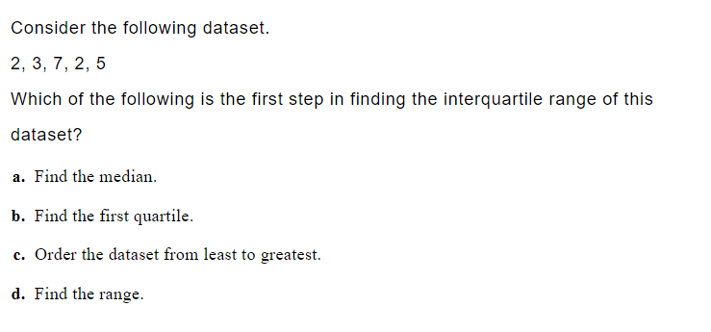
Practice

Slide 14

Answer

Slide 15
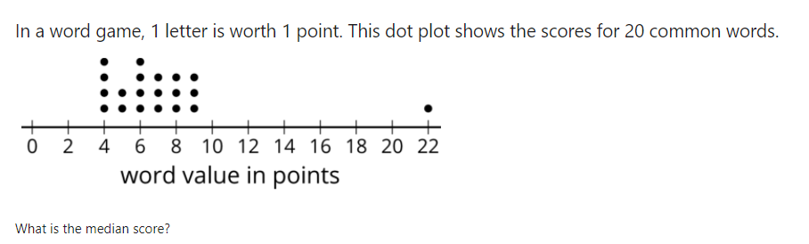
GeoGebra Practice
Calculate Inter quartile range: https://www.geogebra.org/m/TZXc9FJf
Quartiles and Interquartile Range: https://www.geogebra.org/m/bx4hrakp
  Lesson: https://www.geogebra.org/m/bx4hrakp#material/m6bpuavz
  Practice https://www.geogebra.org/m/bx4hrakp#material/j55btte4

Slide 16
Summary
Quartiles divide a data set into quarters.
The extremes are the minimum and maximum values of a data set.
The range is the difference between the maximum and minimum values of a data set.
The interquartile range is the difference between Q3 and Q1.
The IQR tells us how spread out the middle 50% of a data set is.
The IQR is useful for identifying outliers.

