Slide 1
What is Mean Absolute Deviation?
Notes:
Mean Absolute Deviation (MAD) is the average distance between each data point and the mean of the data set. It tells us how spread out the data is from the average. It is calculated by subtracting each data point from the mean of the data set, taking the absolute value of each difference, adding them together and dividing the total by the number of data points.

Slide 2
Key Words
absolute deviation – the absolute value of the distance from the data point to the mean
dataset – a collection of related information
mean – the sum of the data divided by the number of data values
mean absolute deviation – the sum of the absolute deviations divided by the number of data values
outlier – a data point that is significantly different than all of the other data points

Slide 3
Step 1: Find the Mean
Add all the numbers in the data set together
Divide the sum by the total number of data points

Slide 4
Step 2: Find the Absolute Deviations
Subtract each data point from the mean
Take the absolute value of each difference

Slide 5
Step 3: Find the Average Absolute Deviation
Add up all the absolute deviations
Divide the total by the number of data points
Notes:
To find the average absolute deviation, add up all the absolute deviations and divide the total by the number of data points.

Slide 6
Step 4: Interpret the MAD
The MAD tells us how spread out the data is from the mean
A lower MAD indicates that the data is more closely clustered around the mean
A higher MAD indicates that the data is more spread out
Notes:
Interpreting the MAD tells us how spread out the data is from the mean. A lower MAD indicates that the data is more closely clustered around the mean, while a higher MAD indicates that the data is more spread out.

Slide 7
Real-world examples of using Mean Absolute Deviation
Mean Absolute Deviation is widely used in finance, economics, and engineering.
MAD is used to measure the variability of a dataset.
MAD is often used with financial data to calculate risk.
Engineers use MAD to measure the quality of their products.
In economics, MAD is used to measure the deviation of economic indicators.

Slide 8
Example
Data set: 2, 4, 6, 8, 10
Mean: 6
Absolute deviations: 4, 2, 0, 2, 4
Average Absolute Deviation: 2.4

Slide 9
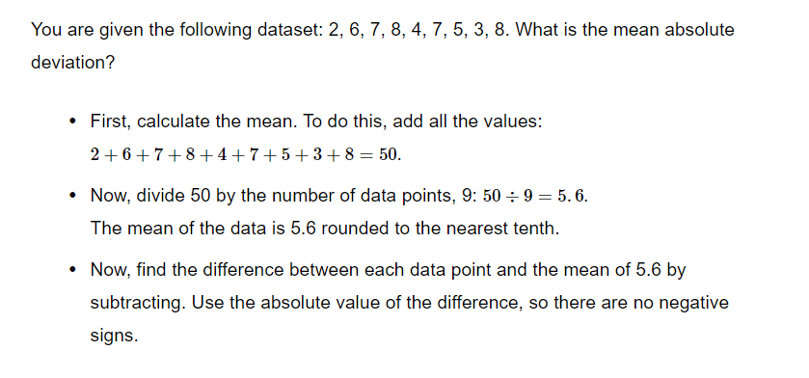
Example

Slide 10
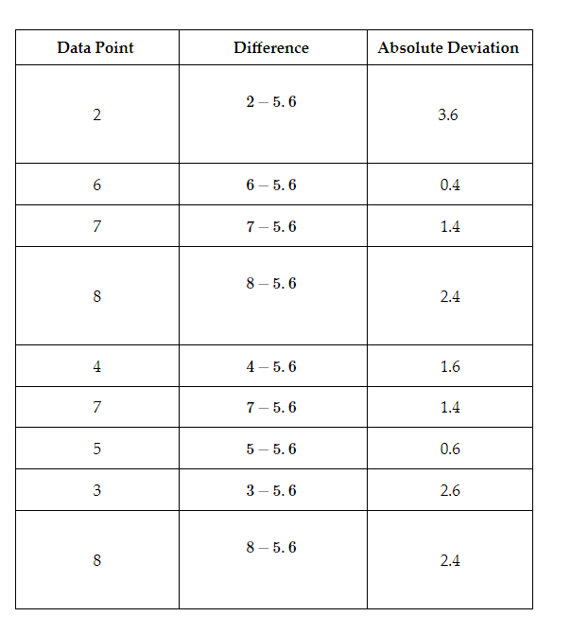
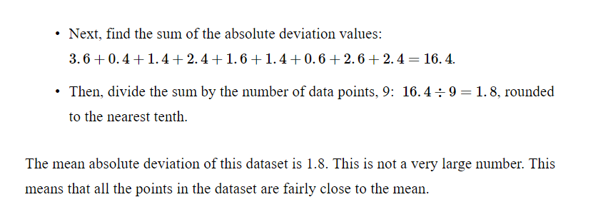

Slide 11

Practice

Slide 12
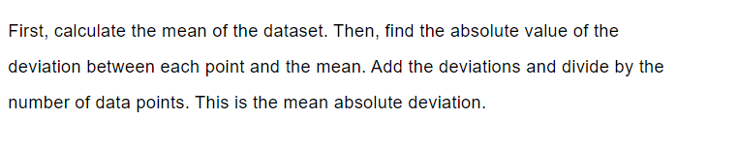
Answer

Slide 13
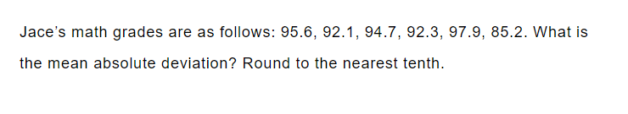
Practice

Slide 14

Answer

Slide 15
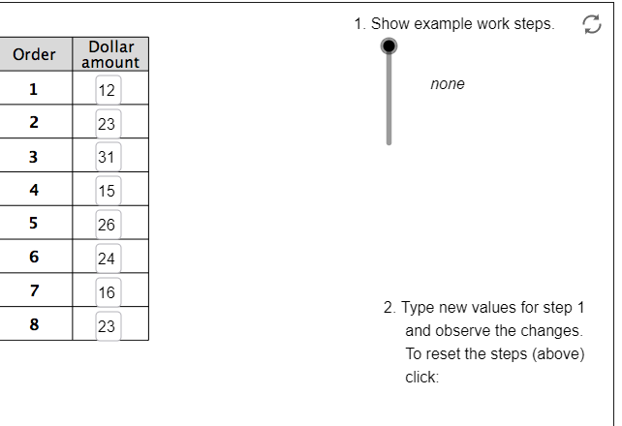
GeoGebra Practice
Calculate Mean Absolute Deviation (M.A.D): https://www.geogebra.org/m/UaMEvgyH#:~:text=To%20find%20the%20mean%20absolute,%7Cdata%20value%20%E2%80%93%20mean%7C.
Mean Absolute Deviation: https://www.geogebra.org/m/uqjjpq8w

Slide 16
Key Points Summary
Mean Absolute Deviation (MAD) measures the variability of a dataset.
MAD tells us how spread out the data is from the mean.
A lower MAD indicates that the data is more closely clustered around the mean, while a higher MAD indicates that the data is more spread out.
MAD is widely used in finance, economics, and engineering.
Engineers use MAD to measure the quality of their products.
In economics, MAD is used to measure the deviation of economic indicators.
Notes:
This slide summarizes the key points of the presentation on Mean Absolute Deviation.

