Slide 1
Volume of a Right Rectangular Prism
Math 6B Unit 6 Lesson 8
Notes:
Welcome to the presentation on how to find the volume of a right rectangular prism. Today, we will be discussing the different formulas that you can use to calculate the volume of both whole number and fractional rectangular prisms. By the end of this presentation, you will be able to solve any volume-related problems with ease.

Slide 2
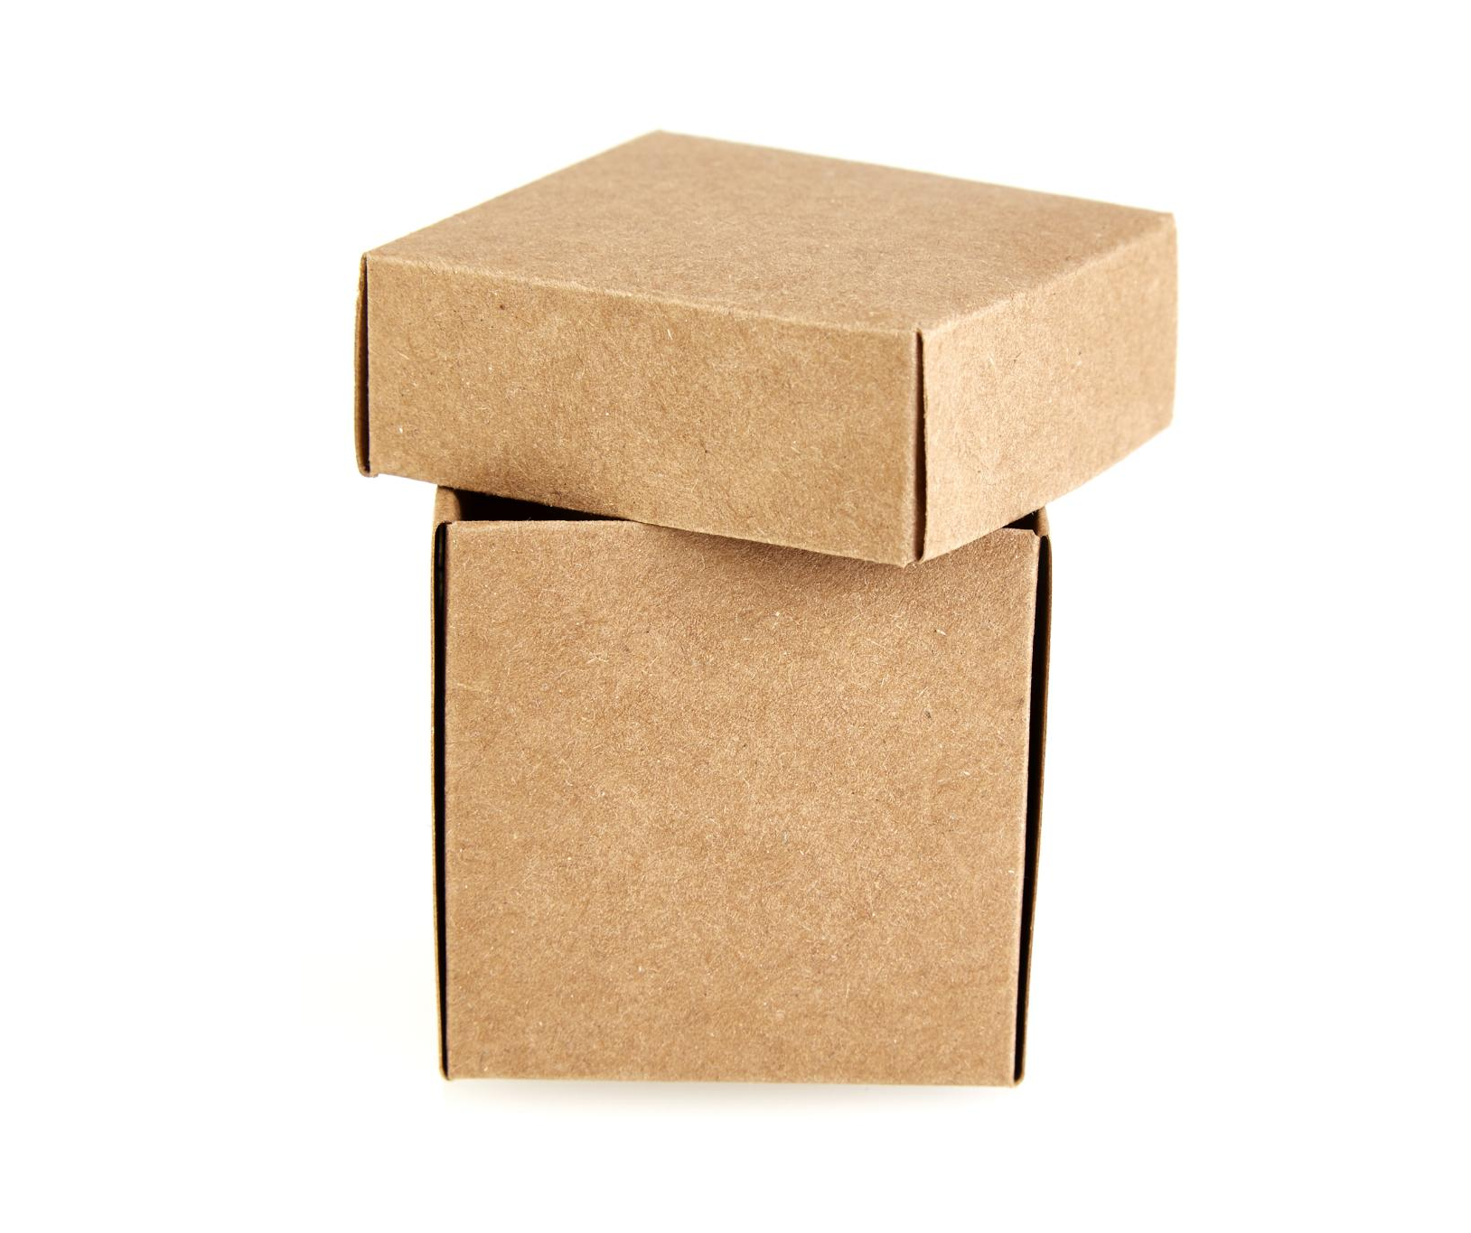
What is a Right Rectangular Prism?
A right rectangular prism is a 3D object that has six faces, with each face being a rectangle.
It has two parallel and congruent bases, and the height is the perpendicular distance between the two bases.
The length, width and height of a right rectangular prism are its three dimensions.
Notes:
Before we dive into how to find the volume of a right rectangular prism, let's first understand what it is. A right rectangular prism is a rectangular box that has three dimensions: length, width and height. It is also known as a cuboid or simply a rectangular prism.

Slide 3
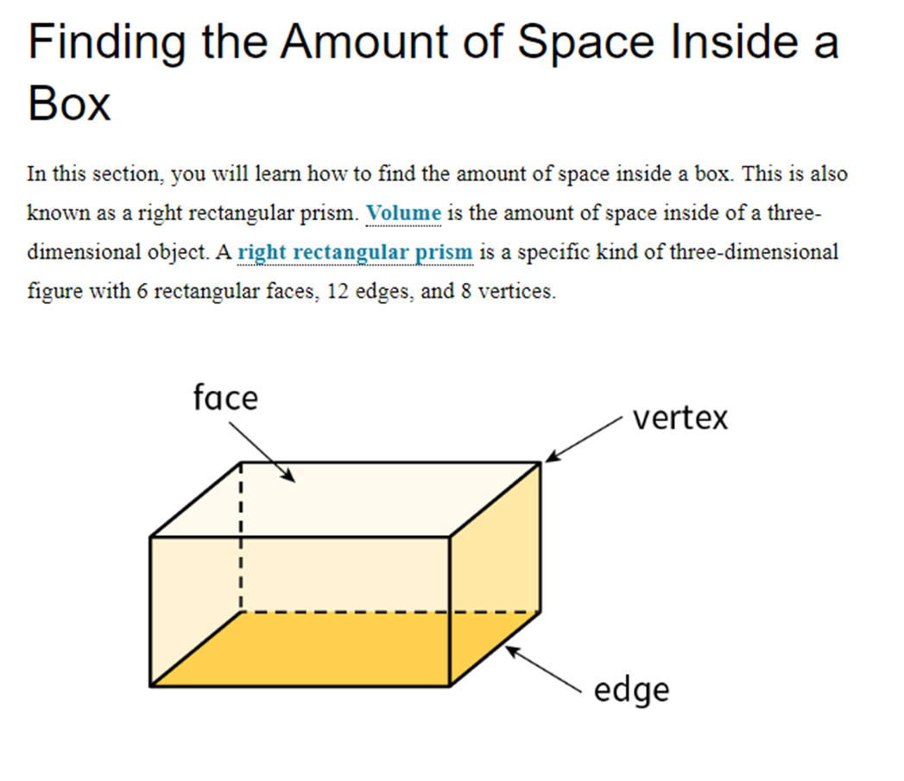

Slide 4
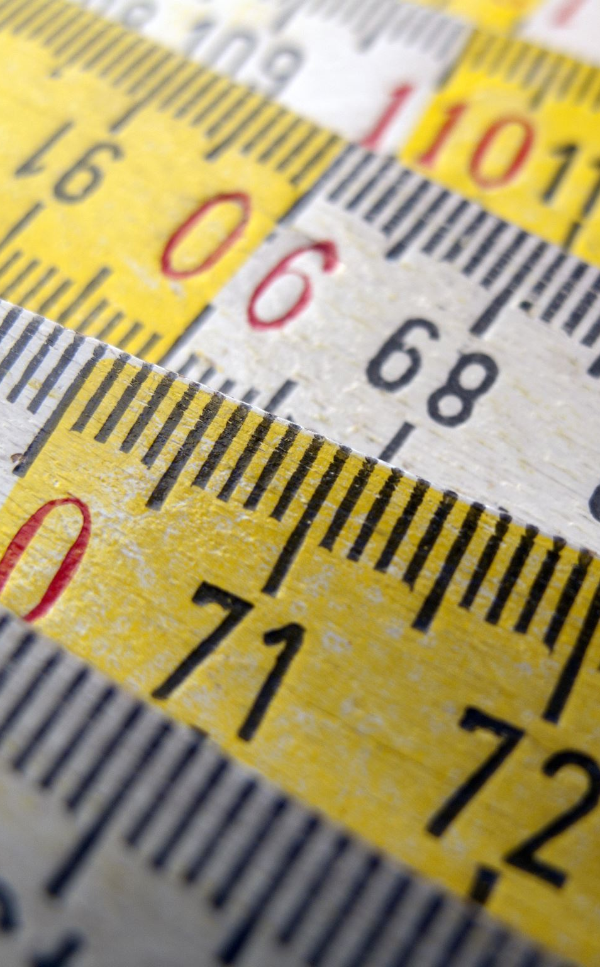
Find the Volume of a Right Rectangular Prism Given Length, Width and Height Using: V = l x w x h
The formula to find the volume of a right rectangular prism with whole number edge lengths is V = l x w x h.
To use this formula, multiply the length, width and height of the rectangular prism.
Make sure that each unit of measurement is the same.
Notes:
Let's now move on to the first method of finding the volume of a right rectangular prism, which is using the formula V = l x w x h. This formula involves multiplying the length, width and height of the rectangular prism. The result will be in cubic units. Make sure that each unit of measurement is the same, for example, centimeters or inches.

Slide 5
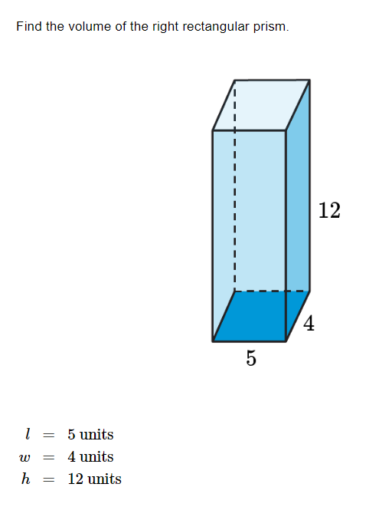
Practice

Slide 6
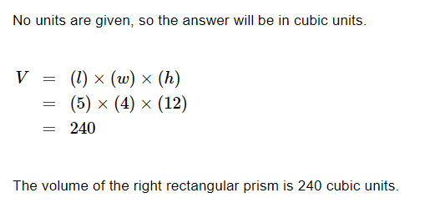
Solve

Slide 7

How to Find the Volume of a Right Rectangular Prism Give Base and Height: V = B x h
The formula to find the volume of a right rectangular prism with whole number edge lengths is V = B x h.
To use this formula, find the area of the base and multiply it by the height of the rectangular prism.
Make sure that each unit of measurement is the same.
Notes:
The second method of finding the volume of a right rectangular prism with whole number edge lengths is using the formula V = B x h. To use this formula, find the area of the base of the rectangular prism and multiply it by the height of the prism. The result will be in cubic units. Again, make sure that each unit of measurement is the same.

Slide 8
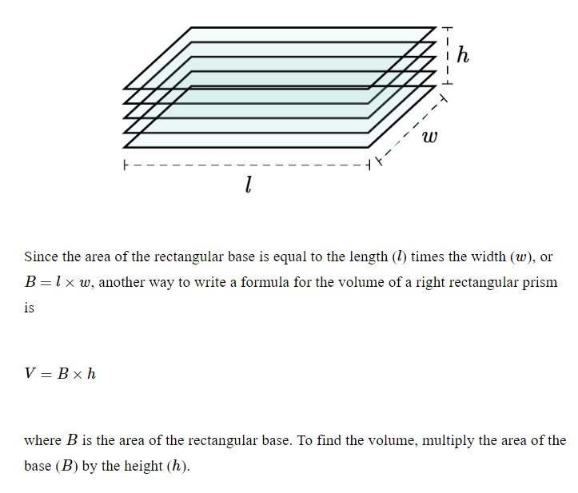
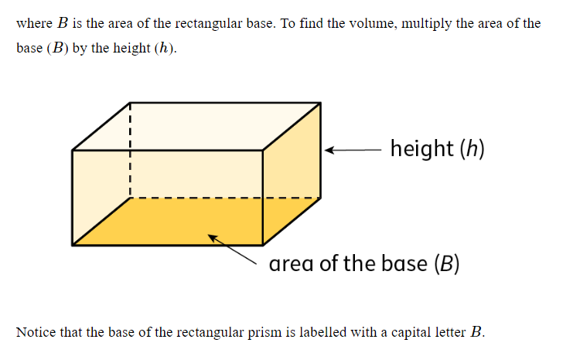
Practice

Slide 9
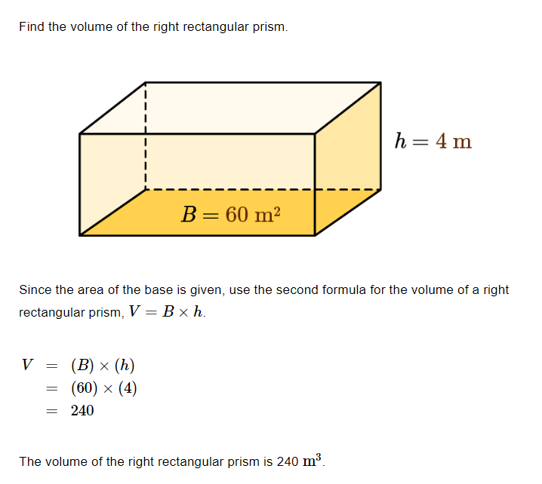
Practice

Slide 10

Real World Examples of Right Rectangular Prisms
Calculating the volume of a swimming pool before filling it with water
Calculating the volume of a box to ensure it can contain a certain amount of items
Calculating the volume of a room to ensure proper ventilation and air conditioning
Notes:
Right rectangular prisms are commonly used in various real-world applications to calculate volume. One such example is when measuring the volume of a swimming pool before filling it with water. Another is calculating the volume of a box to ensure it can contain a certain number of items. Additionally, calculating the volume of a room can help ensure proper ventilation and air conditioning. In each case, the volume of the right rectangular prism can be easily calculated using the appropriate formula.

Slide 11

How to Find the Volume of a Right Rectangular Prism with Fractional Edge Lengths by Packing it with Unit Cubes
To find the volume of a right rectangular prism with fractional edge lengths, we use the packing method.
In this method, we pack the rectangular prism with unit cubes of the appropriate unit fraction edge lengths.
The number of unit cubes required to fill the rectangular prism will give us its volume.
Notes:
Now, let's move on to finding the volume of a right rectangular prism with fractional edge lengths. In this method, we use the packing method, where we pack the rectangular prism with unit cubes of the appropriate unit fraction edge lengths. The number of unit cubes required to fill the rectangular prism will give us its volume. Make sure to use the same unit fraction for the length, width and height of the rectangular prism.

Slide 12
GeoGebra Practice
Working out the volume of a rectangular prism with unit cubes: https://www.geogebra.org/m/B7XktPGA
Volume of a Rectangular Prism: https://www.geogebra.org/m/KwbsyD2k
finding the Volume and Surface Area of a Rectangular Prism: https://www.geogebra.org/m/YmKvYv3A

Slide 13
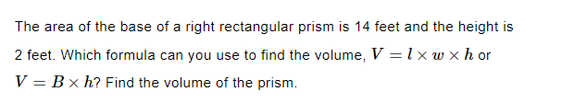
Practice

Slide 14
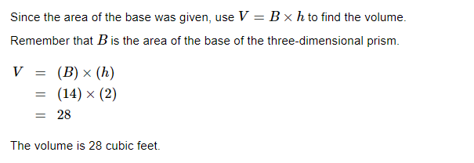
Answer

Slide 15
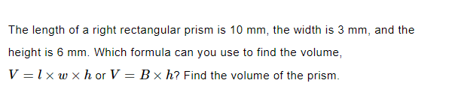
Practice

Slide 16
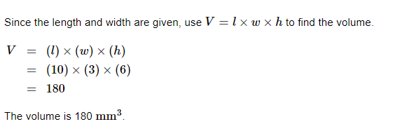
Answer

Slide 17
Summary
A right rectangular prism is a 3D object that has six faces, with each face being a rectangle.
The formulas to find the volume of a right rectangular prism with whole number edge lengths are V = l x w x h and V = B x h.
The packing method is used to find the volume of a right rectangular prism with fractional edge lengths.
Make sure to use the same unit of measurement for each dimension.
Notes:
To summarize, we have learned that a right rectangular prism is a 3D object that has six faces, with each face being a rectangle. We also learned that there are two different formulas to find the volume of a rectangular prism with whole number edge lengths, and the packing method is used to find the volume of a prism with fractional edge lengths. Make sure to use the same unit of measurement for each dimension when solving volume problems.

