Slide 1
Solving Inequalities by Multiplying or Dividing
Math 6B Unit 5; Lesson 5
Notes:
Welcome to this presentation on solving one-step inequalities with multiplication and division. By the end of this presentation, you will be able to solve these types of problems easily.

Slide 2
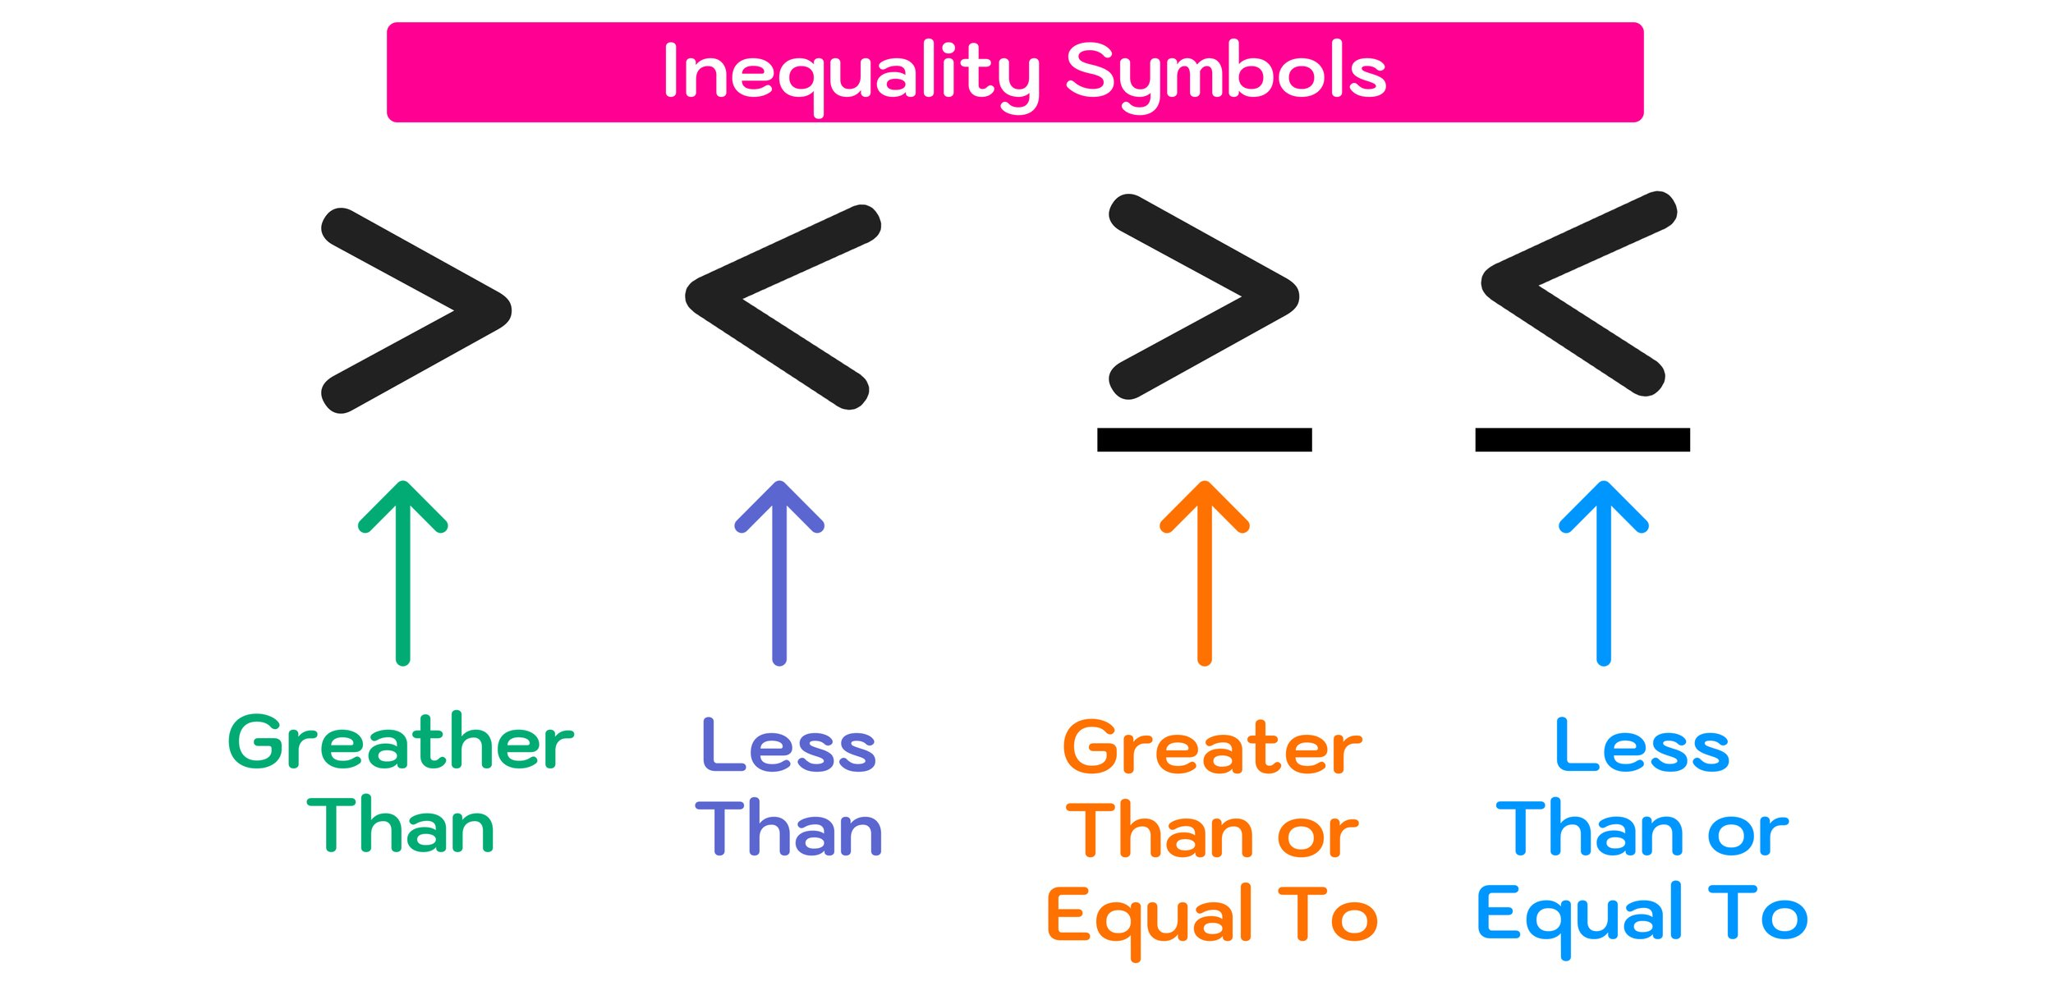
Key Words:
Inequality – a statement that one value is less than, greater than, less or equal to, greater than or equal to, or not equal to another value.
Notes:
Before we dive into solving one-step inequalities with multiplication and division, let's first understand what an inequality is and what a one-step inequality is. We'll also look at examples of one-step inequalities.

Slide 3
Inequalities with Multiplication
4x > 28
If the inequality involves multiplication, solve by using division (÷).
1
Divide both sides by a number that will leave the variable by itself on one side.
2
Notes:
Now, let's learn how to solve one-step inequalities involving multiplication. We'll go over what happens when we multiply by a positive number and when we multiply by a negative number.

Slide 4
Inequalities with Multiplication
4x > 28
4x > 28
4x ÷ 4 > 28 ÷ 4
1
X > 7
2
Notes:
Now, let's learn how to solve one-step inequalities involving multiplication. We'll go over what happens when we multiply by a positive number and when we multiply by a negative number.

Slide 5
Additional Examples of Inequalities Involving Multiplication
Work Space
Example 1: 3x > 9
Example 2: -2y ≤ -6
Example 3: 5z < -10
Notes:
Let's go through some examples of one-step inequalities involving multiplication. We'll solve each problem step-by-step.

Slide 6

Inequalities with Division
$\frac{z}{3}<$17
If the inequality involves division, solve by using multiplication (X).
1
Multiply both sides by a number that will leave the variable by itself on one side.
2
Notes:
Now, let's learn how to solve one-step inequalities involving multiplication. We'll go over what happens when we multiply by a positive number and when we multiply by a negative number.

Slide 7
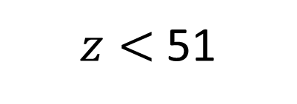
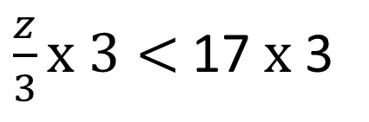
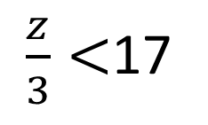
Inequalities with Division
$\frac{z}{3}<$17
1
2
$\frac{z}{3}<$17
$z<$51
$\frac{z}{3}x 3<$17 $x$ 3
Notes:
Now, let's learn how to solve one-step inequalities involving multiplication. We'll go over what happens when we multiply by a positive number and when we multiply by a negative number.

Slide 8
Additional Examples of Inequalities Involving Division
Work Space
Example 1: 4p/2 ≥ 8
Example 2: -10q/5 < 2
Example 3: 6r/-3 > -2
Notes:
Let's take a look at some examples of one-step inequalities involving division. We'll take each problem step-by-step.

Slide 9
Practice Problems: Multiplication and Division
Practice problems
Notes:
Now it's time to practice! Here are some problems for you to solve on your own. Remember to identify whether you need to multiply or divide, and if you need to multiply or divide by a positive or negative number.

Slide 10
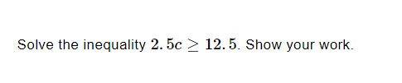
Practice

Slide 11
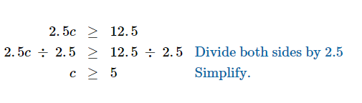
Answer

Slide 12

Practice

Slide 13
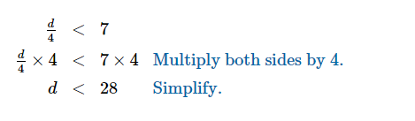
Answer

Slide 14
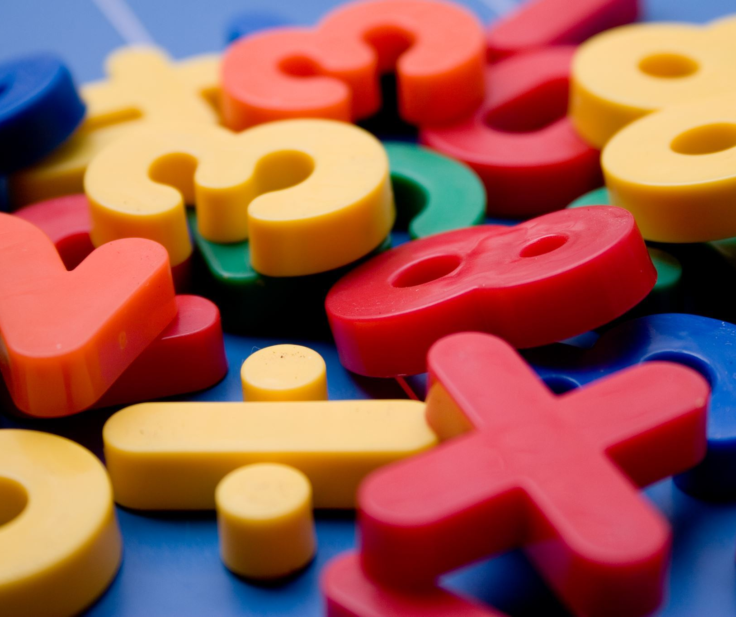
Review Multiplication in One-Step Inequalities
Multiplying by a positive number in one-step inequalities means that the variable will get bigger.
Multiplying by a negative number in one-step inequalities means that the variable will get smaller.
Examples of multiplication in one-step inequalities include 2x > 8 and -3y ≤ 9.
Notes:
Multiplication is an important operation in solving one-step inequalities. In this slide, we will learn how to use multiplication in one-step inequalities.

Slide 15
Review: Division in One-Step Inequalities
Dividing by a positive number in one-step inequalities means that the variable will get smaller.
Dividing by a negative number in one-step inequalities means that the variable will get bigger.
Examples of division in one-step inequalities include 2x/3 < 6 and -y/-4 > 5.
Notes:
Division is another important operation in solving one-step inequalities. In this slide, we will learn how to use division in one-step inequalities.

Slide 16
Combining Multiplication and Division in One-Step Inequalities
Sometimes we need to use both multiplication and division in one-step inequalities.
Examples of combining multiplication and division in one-step inequalities include 3x/2 > 9 and -4y/3 < -6.
Notes:
In this slide, we will learn how to combine multiplication and division in one-step inequalities.

Slide 17
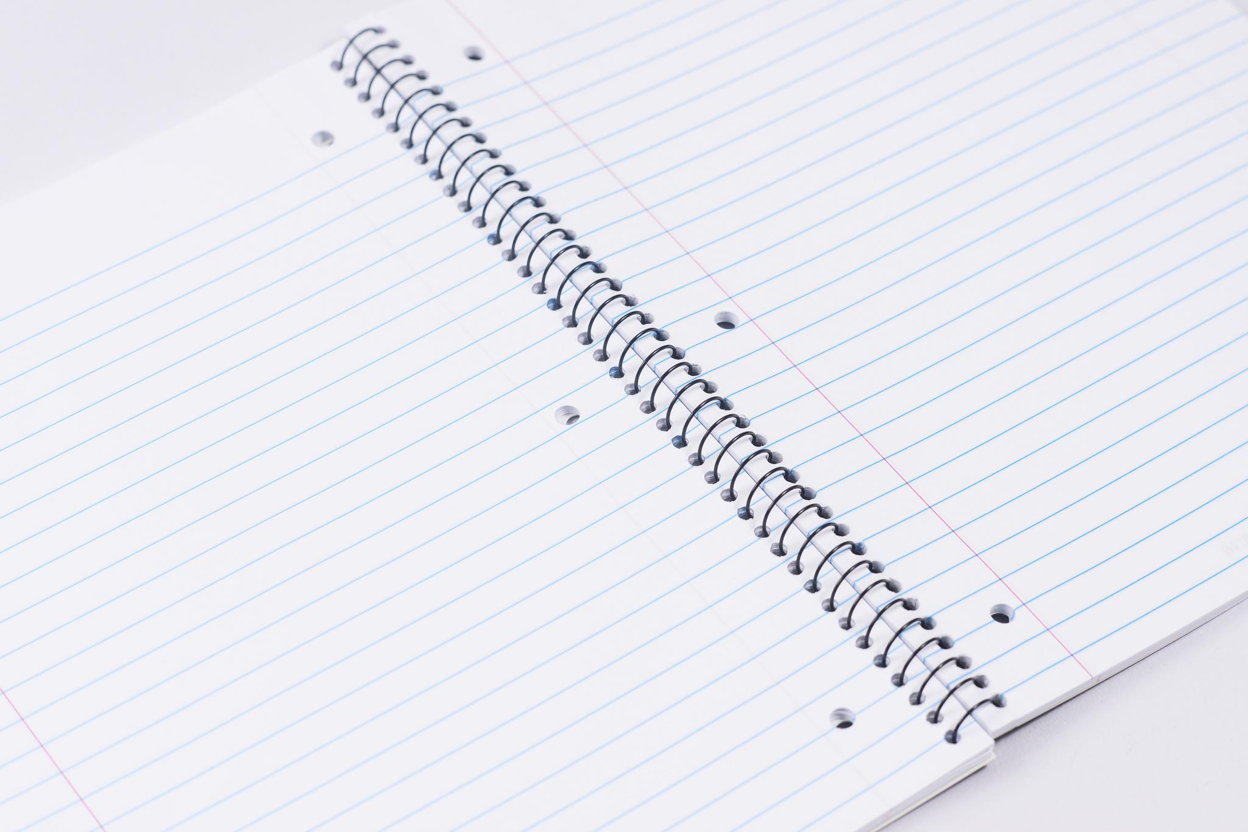
Practice Problems: Multiplication and Division
Practice Problem 1: 2x > 8
Practice Problem 2: -3y/-2 < 6
Practice Problem 3: z/5 ≤ -3
Notes:
In this slide, we will practice solving one-step inequalities that involve multiplication and division.

Slide 18
Answer: Practice Problems
Practice Problem 1: x > 4
Practice Problem 2: y > 12
Practice Problem 3: z ≤ -15
Notes:
Here are the answers to the practice problems from the previous slide.

Slide 19
Review
Inequalities are equations that compare two values using the symbols >, <, ≥, or ≤.
A one-step inequality is a mathematical statement with one operation.
Multiplying by a positive number in one-step inequalities means that the variable will get bigger.
Multiplying by a negative number in one-step inequalities means that the variable will get smaller.
Dividing by a positive number in one-step inequalities means that the variable will get smaller.
Dividing by a negative number in one-step inequalities means that the variable will get bigger.
Sometimes we need to use both multiplication and division in one-step inequalities.
Notes:
In this slide, we will review the main concepts and operations that we learned in this presentation.

