Slide 1
How to Show Solution Set of an Inequality on a Number Line
Math 6B Unit 5 Lesson 5
Notes:
Welcome to the presentation on how to show the solution set of an inequality on a number line. In this presentation, you will learn how to graph an inequality on a number line and how to find the solution set. Let's get started.

Slide 2
Graphing Inequalities on a Number Line
Draw
Draw a number line.
Identify
Identify the variable.
Plot
Plot the inequality symbol on the number line.
Notes:
To graph an inequality on a number line, you need to draw a number line and identify the variable. Then, you plot the inequality symbol on the number line. If the symbol is > or ≥, use a closed circle (●) to indicate that the point is included in the solution set. If the symbol is < or ≤, use an open circle (○) to indicate that the point is not included in the solution set.

Slide 3
Shading the Solution Set
Test a point.
Shade left or right of the point based on the inequality symbol.
Notes:
To shade the solution set on the number line, you need to test a point that is not on the line. If the point satisfies the inequality, shade the side of the number line that the point is on. If the point does not satisfy the inequality, shade the other side of the number line. The shaded area represents the solution set of the inequality.

Slide 4
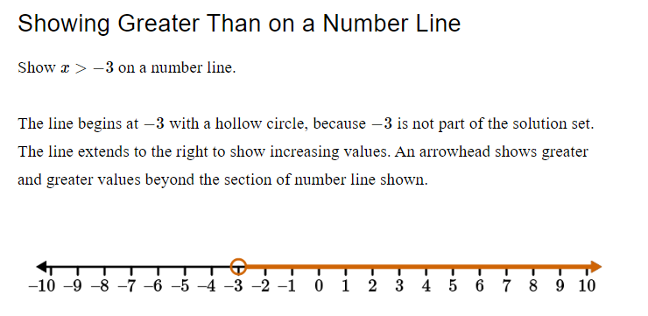

Slide 5
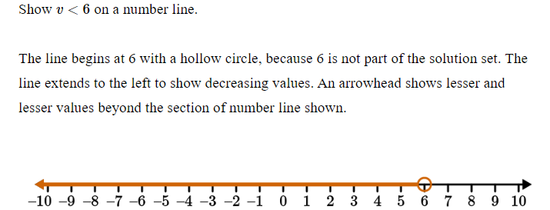
Showing Less Than on a Number Line

Slide 6
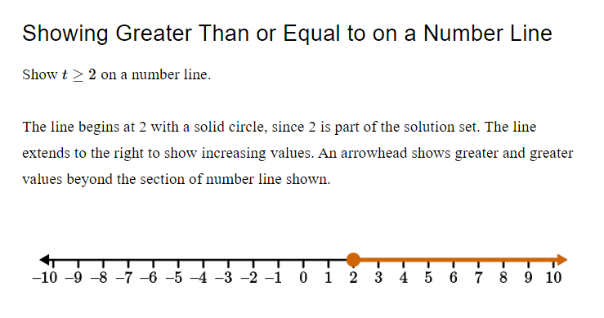

Slide 7
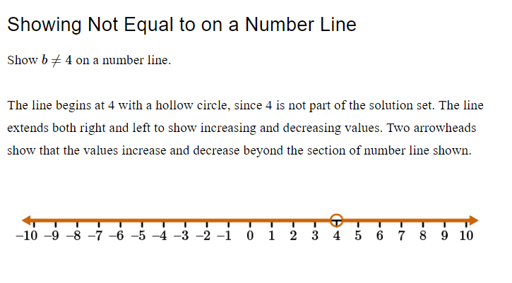

Slide 8
Examples of Graphing Inequalities on a Number Line
x > 1
y ≤ -2
z ≥ 3
Notes:
Here are some examples of how to graph inequalities on a number line. For x > 1, we plot a closed circle at 1 and shade to the right. For y ≤ -2, we plot a closed circle at -2 and shade to the left. For z ≥ 3, we plot a closed circle at 3 and shade to the right.

Slide 9

Practice Time
Graph the inequality: w < -4.
Find the solution set.
Notes:
Now it's time to practice. Graph the inequality w < -4 on a number line. Then, find the solution set and shade it on the number line. Good luck!

Slide 10
GeoGebra Practice
Positive and Negative Numbers in a Bank Account: https://www.geogebra.org/m/hngppxjw
Graphing Inequalities from Mathematical Notation: https://www.geogebra.org/m/ns2xr6na
Graphing Inequalities on the Number Line: https://www.geogebra.org/m/bYGED3dY

Slide 11
When does an inequality have infinitely many solutions?
If the inequality contains ≤ or ≥, it has infinitely many solutions if the inequality symbol is < or > respectively.
If the inequality contains < or >, it has infinitely many solutions if the inequality symbol is ≤ or ≥ respectively.
Notes:
Explain to the students when an inequality has infinitely many solutions. Then use an example to show them how to identify when an inequality has infinitely many solutions.

Slide 12
Examples of Inequalities with infinitely many solutions
y > 0 (contains >, but symbol is not ≤ or ≥)
x ≤ 5 (contains ≤, but symbol is not < or >)
z < -2 (contains <, but symbol is not ≥ or ≤)
w ≥ 3 (contains ≥, but symbol is not > or <)
Notes:
Show students examples of inequalities with infinitely many solutions.

Slide 13
GeoGebra Practice
Systems of Linear Equations: https://www.geogebra.org/m/gB32KcAu

Slide 14
Key Points
Graphing inequalities on a number line
Shading the solution set
Testing a point
Examples of graphing inequalities
When an inequality has infinitely many solutions
GeoGebra practice

