Slide 1
Mastering Equivalent Expressions
Math 6B Unit 3 Lesson 9
Notes:
Welcome to this lesson on how to identify equivalent expressions. In this presentation, we will learn how to recognize when two expressions are equivalent and the steps for checking if they are equal or not.

Slide 2
Key Words
Commutative Property – a property of operations that states the order of addition and the order of multiplication can occur in any order
Distributive Property – a property of operations that states that multiplying a number or variable by a sum or difference is the same as the sum or difference of the product of that number/variable and each term being added or subtracted
equivalent expressions – two expressions that are the same when simplified and always have the same value
Identity Property – a property of operations that states that any number added to 0 is itself, and any number multiplied by 1 is itself

Slide 3
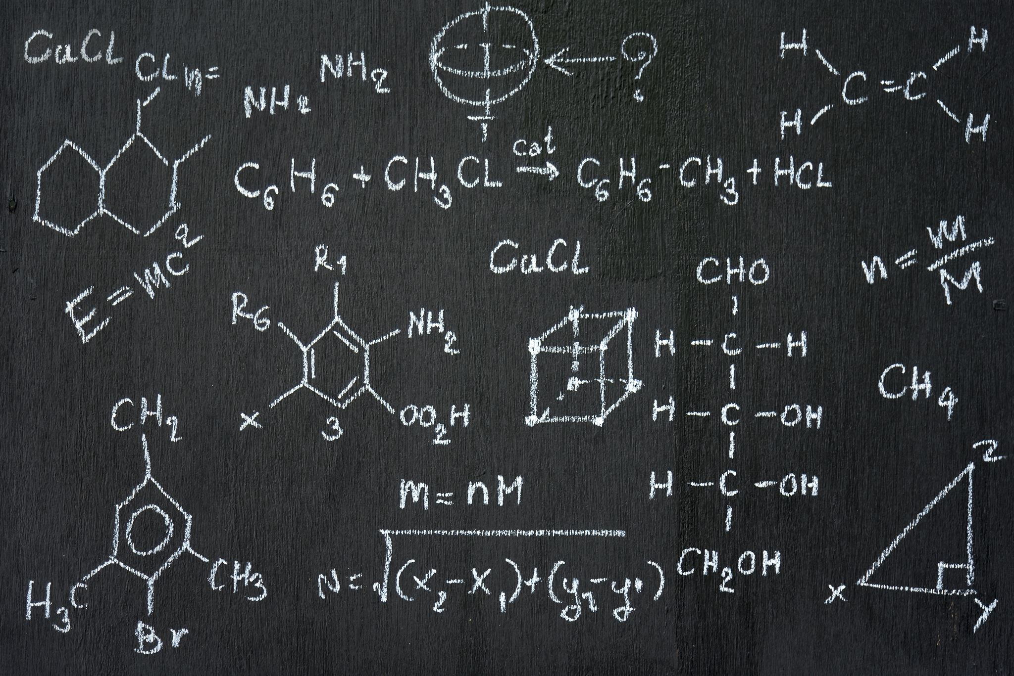
What are equivalent expressions?
Two expressions are equivalent if they have the same value for every possible substitution of numbers or variables.
For example, x + 4 and 5 + x are equivalent expressions, since they both have the same value for any value of x.
Notes:
Equivalent expressions are two or more mathematical expressions that are equal in value, even though they may look different. These expressions may have different numbers, variables, or operations, but they have the same simplified value.

Slide 4
How to Identify Equivalent Expressions
One way to identify equivalent expressions is to simplify them.
If the simplified forms of two expressions are equal, then the original expressions are equivalent.
You can simplify expressions by combining like terms and applying the distributive property.
Notes:
To identify whether expressions are equivalent or not, we can simplify each expression and compare them. If we get the same result, then the two expressions are equivalent. For this, we need to simplify each expression using the order of operations and combining like terms.

Slide 5
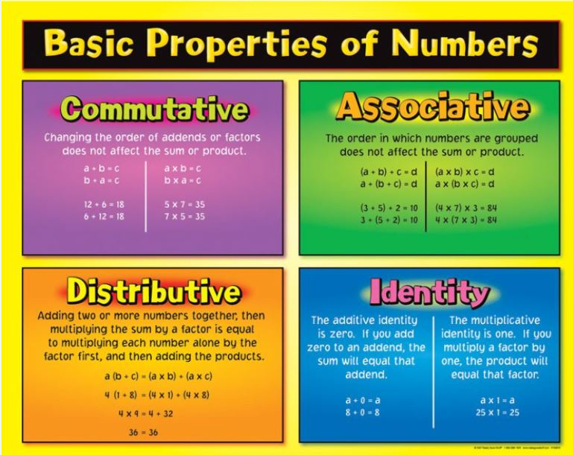
Properties of Operations
There are four basic properties of operations in arithmetic: commutative, associative, distributive, and identity
These same properties also apply to algebraic expressions
Using these properties can help you generate equivalent expressions
Notes:
In arithmetic, we use properties of operations to change the order of operations and still get the same answer. Similarly, we can use properties of operations in algebra to generate equivalent expressions.

Slide 6
Commutative Property
The commutative property states that the order of the terms doesn't matter as long as we're only adding or multiplying
For example, a + b is equivalent to b + a and 2 * 3 is equivalent to 3 * 2
We can apply the commutative property to generate equivalent expressions
Notes:
The commutative property works for addition and multiplication. It does not work with subtraction or division.

Slide 7
Associative Property
The associative property states that the grouping of terms doesn't matter as long as we're only adding or multiplying
For example, (a + b) + c is equivalent to a + (b + c) and (2 * 3) * 4 is equivalent to 2 * (3 * 4)
We can apply the associative property to generate equivalent expressions
Notes:
The commutative property works for addition and multiplication. It does not work with subtraction or division.

Slide 8
Distributive Property
The distributive property states that we can multiply a term by a sum or difference by multiplying each term inside the parentheses by the same term and adding or subtracting the results
For example, 3(a + b) is equivalent to 3a + 3b and 2(x - 4) is equivalent to 2x - 8
We can apply the distributive property to generate equivalent expressions
Notes:
The commutative property works for addition and multiplication. It does not work with subtraction or division.

Slide 9
Practice Time
Here are a few examples for you to practice identifying equivalent expressions.
Simplify the expressions and check whether they are equivalent or not.
Notes:
Now it's time to practice. Here are a few example expressions for you to simplify and determine whether they are equivalent or not. Remember to show your work and check your answers!

Slide 10
Example 1
3x + 5 - 2x
4x + 5
Notes:
Let's look at another example. We want to simplify 3(x - 2) + 6 and 3x and then check whether they are equivalent. The first expression simplifies to 3x - 6 + 6 which is equal to 3x and the second expression is simply 3x. Thus, the two expressions are equivalent.

Slide 11
Example 2
3(x - 2) + 6
3x
Notes:
Let's look at another example. We want to simplify 3(x - 2) + 6 and 3x and then check whether they are equivalent. The first expression simplifies to 3x - 6 + 6 which is equal to 3x and the second expression is simply 3x. Thus, the two expressions are equivalent.

Slide 12
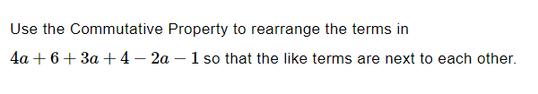
Practice

Slide 13
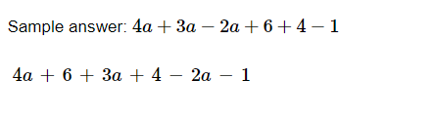
Answer

Slide 14
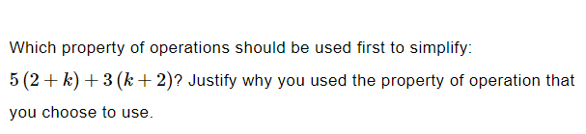
Practice

Slide 15
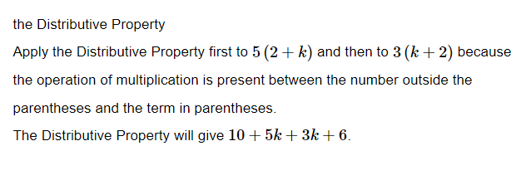
Answer

Slide 16

Practice

Slide 17
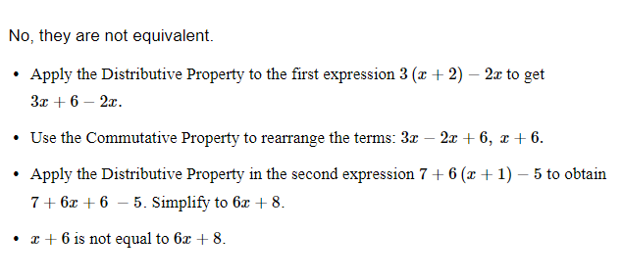
Answer

Slide 18
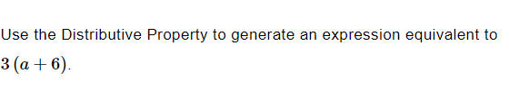
Practice

Slide 19

Answer

Slide 20
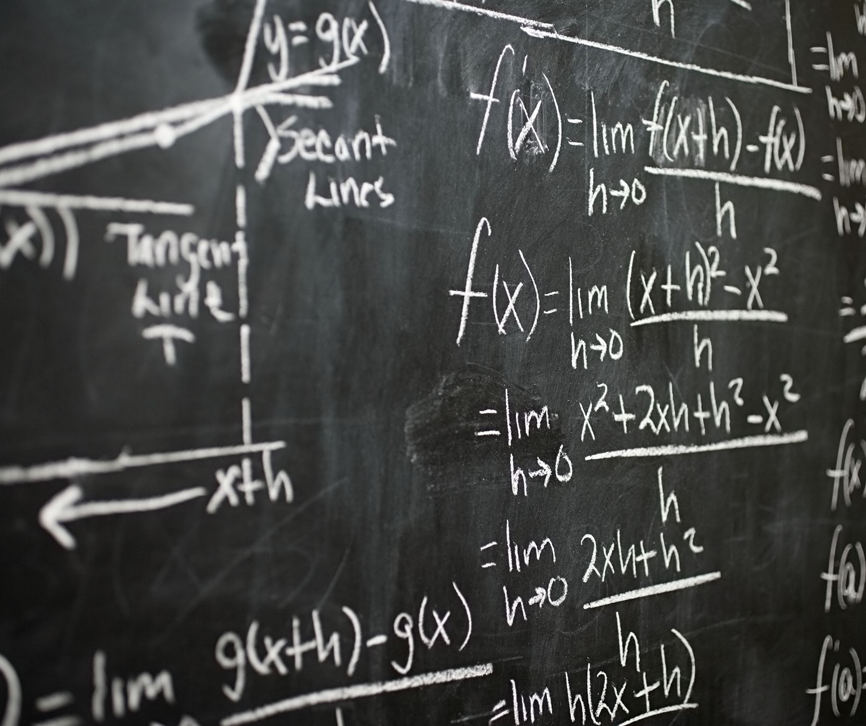
Summary
What are equivalent expressions?
How to Identify Equivalent Expressions
Properties of Operations
Practice Time

