Slide 1
Properties of Operations
Math 6B Unit 3 Lesson 8

Slide 2
Associative Property of Addition
Numbers can be added in any order
Changing the grouping of numbers does not change their sum
Notes:
The associative property of addition states that the way in which we group numbers for addition does not affect the final result. When adding three or more numbers, we can regroup them in any way we want and still get the same answer.

Slide 3
Commutative Property of Addition
Order of numbers can be changed
The sum remains the same
Notes:
The associative property of addition states that the way in which we group numbers for addition does not affect the final result. When adding three or more numbers, we can regroup them in any way we want and still get the same answer.

Slide 4
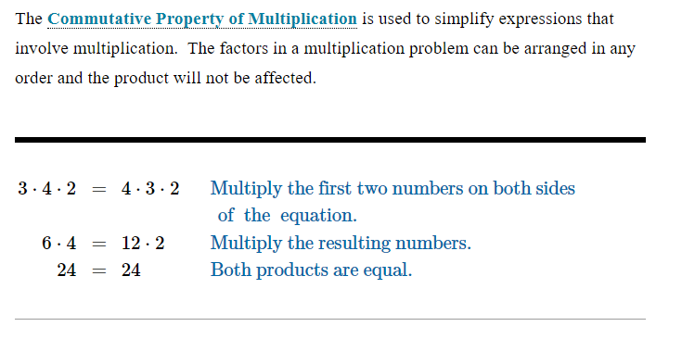
Commutative Property of Multiplication
Notes:
The commutative property of multiplication states that we can multiply numbers in any order we want and still get the same answer. For example, 2 × 3 is the same as 3 × 2. We can even multiply more than two numbers and it still applies.

Slide 5
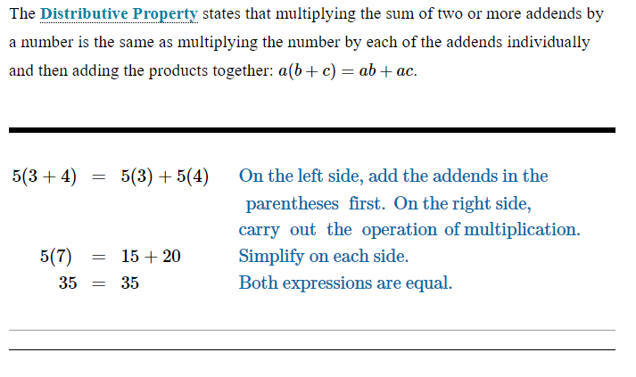
Distributive Property
Notes:
The distributive property of multiplication states that when we have a number outside a set of parentheses that contains addition, we can distribute the multiplication across the terms inside the parentheses. This is useful when we need to simplify expressions. For example, 2 × (3 + 4) is the same as 2 × 3 + 2 × 4.

Slide 6

Practice

Slide 7
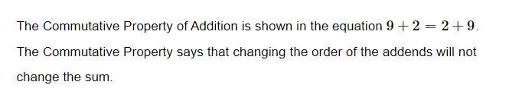
Answer

Slide 8

Practice

Slide 9
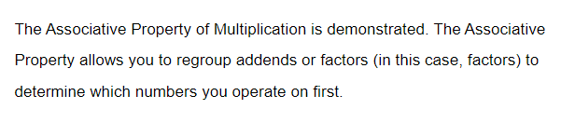
Answer

Slide 10
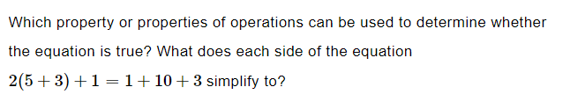
Practice

Slide 11
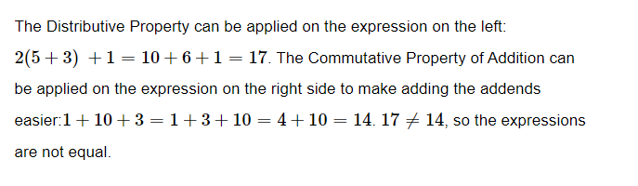
Answer

Slide 12
GeoGebra Practice
Commutative Property of Multiplication Using Models: https://www.geogebra.org/m/xkanfndj
Distributive property: https://www.geogebra.org/m/uBFDkKgn
Multiplication properties: https://www.geogebra.org/m/nn8vmpap

Slide 13
Summary
Associative Property of Addition: Numbers can be added in any order. Changing the grouping of numbers does not change their sum.
Commutative Property of Addition: Order of numbers can be changed. The sum remains the same.
Commutative Property of Multiplication: Order of numbers can be changed. The product remains the same.
Distributive Property Multiplying the sum of two of more addends by a number is the same as multiplying the number by each of the addends individually and then adding the products together.

