Slide 1
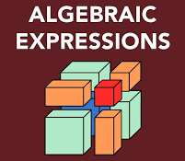
Translating Words into Algebraic Expressions
Math 6B Unit 3 Lesson 5
Notes:
Welcome to this lesson on Translating Words into Algebraic Expressions. We will be discussing how to express word problems in mathematical terms.

Slide 2
Key Words
algebraic expression – a combination of at least one variable and a mathematical operation
difference – the result of subtracting two quantities
product – the result of multiplying two quantities
quotient – the result of dividing two quantities
sum – the result of adding two quantities
variable – a letter used to represent a number that is unknown

Slide 3
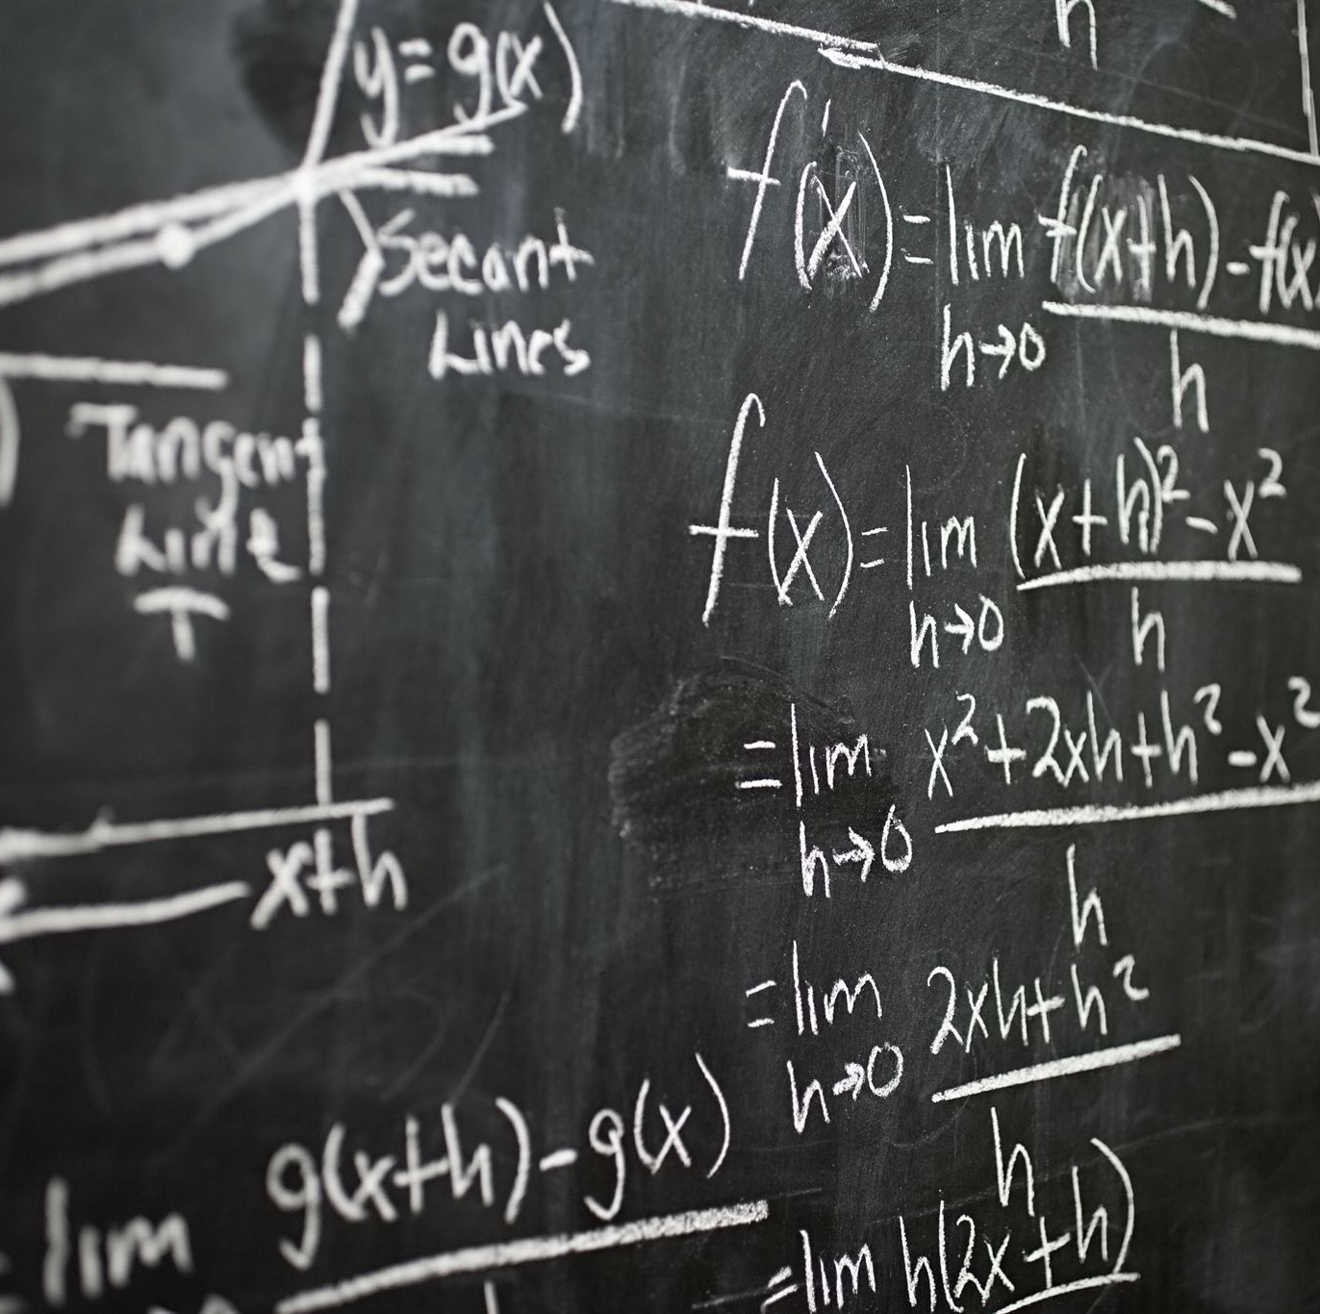
What are Algebraic Expressions?
Algebraic expressions are mathematical statements that use symbols and numbers
The symbols used in algebra are variables and mathematical operators
Algebraic expressions cannot be solved, only simplified
Notes:
Algebraic expressions are mathematical statements that use symbols and numbers to represent different quantities. The symbols used in algebra are variables and mathematical operators. It is important to note that algebraic expressions cannot be solved, only simplified.

Slide 4
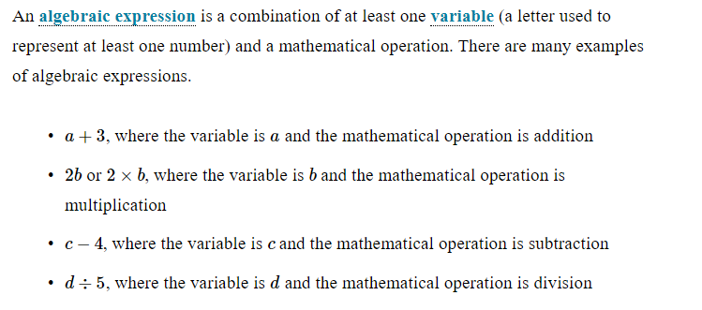
Algebraic Expressions

Slide 5
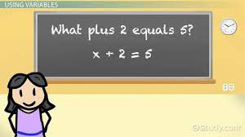
Identifying Variables
Variables are represented by letters in algebraic expressions
Variables are used to represent unknown quantities or values
Notes:
Variables are one of the key components of algebraic expressions. They are represented by letters in algebraic expressions, and are used to represent unknown quantities or values. It is important to identify variables in word problems to be able to create the corresponding algebraic expression.

Slide 6

Mathematical Operators
Mathematical operators are symbols used to show mathematical operations
The most common operators are addition (+), subtraction (-), multiplication (*), and division (/)
Notes:
Mathematical operators are symbols used to show mathematical operations. The most common operators are addition (+), subtraction (-), multiplication (*), and division (/). It is important to use the correct operator when translating a word problem into an algebraic expression.

Slide 7

Example 1: Addition
Addition is represented by the plus (+) symbol
Start by identifying the two quantities being added
Use a variable to represent each quantity
Write the addition operation using the variables
Notes:
Here is an example of how to translate an addition word problem into an algebraic expression. Start by identifying the two quantities being added, and use a variable to represent each quantity. Then, write the addition operation using the variables and the plus (+) symbol.

Slide 8
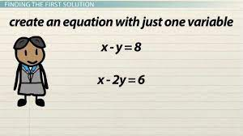
Example 2: Subtraction
Subtraction is represented by the minus (-) symbol
Start by identifying the two quantities being subtracted
Use a variable to represent each quantity
Write the subtraction operation using the variables
Notes:
Here is an example of how to translate a subtraction word problem into an algebraic expression. Start by identifying the two quantities being subtracted, and use a variable to represent each quantity. Then, write the subtraction operation using the variables and the minus (-) symbol.

Slide 9
Example 3: Multiplication
Multiplication is represented by the asterisk (*) symbol
Start by identifying the two quantities being multiplied
Use a variable to represent each quantity
Write the multiplication operation using the variables
Notes:
Here is an example of how to translate a multiplication word problem into an algebraic expression. Start by identifying the two quantities being multiplied, and use a variable to represent each quantity. Then, write the multiplication operation using the variables and the asterisk (*) symbol.

Slide 10

Example 4: Division
Division is represented by the forward slash (/) symbol
Start by identifying the two quantities being divided
Use a variable to represent each quantity
Write the division operation using the variables
Notes:
Here is an example of how to translate a division word problem into an algebraic expression. Start by identifying the two quantities being divided, and use a variable to represent each quantity. Then, write the division operation using the variables and the forward slash (/) symbol.

Slide 11

Putting it All Together
Read the word problem carefully to identify the quantities and operations involved
Identify the variables to represent the quantities
Write the algebraic expression using the variables and mathematical operators
Notes:
To translate a word problem into an algebraic expression, it is important to read the problem carefully to identify the quantities and operations involved. Then, identify the variables to represent the quantities, and write the algebraic expression using the variables and mathematical operators.

Slide 12
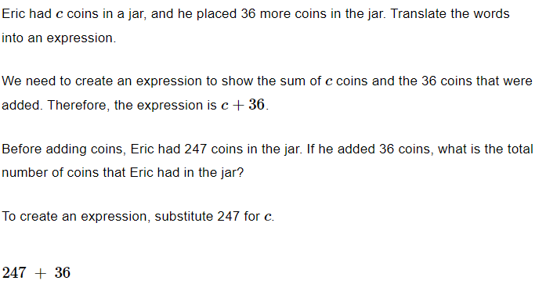
Example

Slide 13
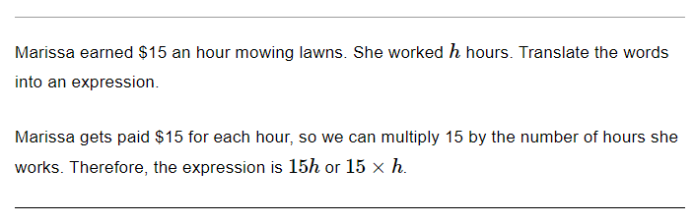
Example

Slide 14

Practice Problems
Solve the following word problems by translating them into algebraic expressions
1) The sum of twice a number and 4
2) Four less than three times a number
3) One half of a number increased by 8
Notes:
Now, let's practice translating word problems into algebraic expressions. Solve the following problems by identifying the quantities and operations involved, and then writing the corresponding algebraic expression.

Slide 15
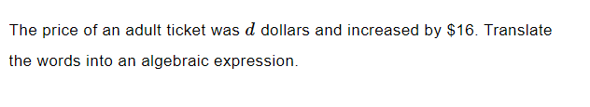
Practice

Slide 16

Solution

Slide 17

Practice

Slide 18

Solution

Slide 19

Translating Algebraic Expressions into Words
An algebraic expression involves variables, numbers, and operations.
The steps to translate an algebraic expression into words are to identify the variables, identify the operations, translate the operations, and put it all together.
For example, the expression 3x + 4 could be translated as 'the sum of three times a number and four.'
Notes:
On this slide, we will teach middle school students how to translate algebraic expressions into words. We will cover the steps involved in translating expressions, and provide an example to demonstrate the process.

Slide 20
Translating Algebraic Expressions into Words
The order of operations must be followed when translating an algebraic expression into words.
The order of operations is Parentheses, Exponents, Multiplication and Division (from left to right), Addition and Subtraction (from left to right).
For example, the expression 2 + 3 * 4 could be translated as 'two added to the product of three and four,' not 'the product of two and the sum of three and four.'
Notes:
On this slide, we will continue to teach middle school students how to translate algebraic expressions into words. We will cover the order of operations and provide an example to demonstrate how to correctly translate an expression.

Slide 21
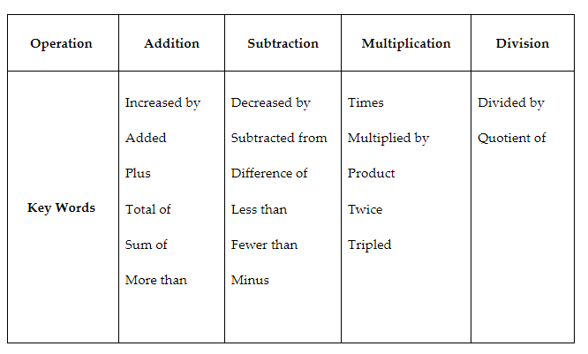
Key Words to Translate Algebraic Expressions

Slide 22
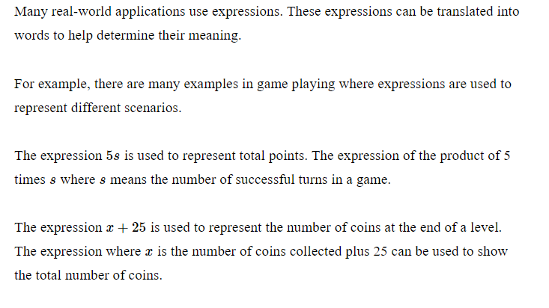
Real World Examples

Slide 23

Practice

Slide 24

Solution

Slide 25
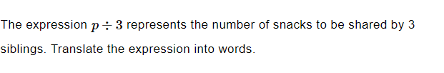
Practice

Slide 26

Solution

Slide 27
Summary
Algebraic expressions use symbols and numbers to represent quantities and operations
Variables are used to represent unknown quantities or values
The most common operators are addition, subtraction, multiplication, and division
To translate a word problem into an algebraic expression, identify the quantities and operations, and write the expression using variables and operators
Notes:
In summary, algebraic expressions use symbols and numbers to represent quantities and operations. Variables are used to represent unknown quantities or values, and the most common operators are addition, subtraction, multiplication, and division. To translate a word problem into an algebraic expression, identify the quantities and operations, and write the expression using variables and operators.

