Slide 1

Welcome to the World of Variables
Math 6B Unit 3 Lesson 3
Notes:
Today, we will learn about variables, which are useful tools in solving math problems. Variables help us to represent unknown values in equations or word problems. Let's get started!

Slide 2
Key Words
coefficient – a number used to multiply a variable in an expression
variable – a symbol used to represent a quantity that can assume different values
expression – a math sentence using numbers, operations, and variable(s), but not an equal sign
unit rate – a rate with 1 in the denominator

Slide 3
What is a Coefficient?
A coefficient is a number that multiplies a variable
A coefficient can be positive or negative
A coefficient can also be a fraction or decimal
A variable without a coefficient has an implied coefficient of 1
Notes:
A coefficient is a number that is multiplied by a variable. It can be positive or negative, whole or decimal. For example, in the expression 2x + 3, the coefficient of x is 2. If a variable doesn't have a coefficient, it's automatically assumed to be 1. For example, in the expression x + 5, the coefficient of x is 1.

Slide 4

Welcome to the World of Variables
Defining Variables
Using Variables in Equations
Using Variables in Word Problems
Practice Makes Perfect
Writing Expressions with Variables
Notes:
Welcome everyone to the world of variables. Today we are going to talk about variables and their importance in mathematics. In the next few slides, we will define what variables are, learn how to use them in equations and word problems, and practice solving some problems with variables. Lastly, we will learn how to write expressions with variables to solve more complex problems.

Slide 5
Defining Variables
Variables are letters or symbols used to represent unknown quantities in a mathematical equation or word problem.
Variables are usually represented by the letters x, y, or z, but other letters and symbols can be used.
The value of a variable can change depending on the problem.
Variables can help us to solve problems more efficiently and accurately.
Notes:
In math, variables are unknown numbers that we represent using letters or symbols. Most commonly, the letters x, y, and z are used to represent variables, but other letters and symbols can be used as well. Variables allow us to solve problems more efficiently and accurately.

Slide 6
Using Variables in Equations
When we use variables in equations, we can write an equation that is true for any value of the variable.
To solve an equation with a variable, we need to isolate the variable on one side of the equation.
We can use inverse operations to solve equations with variables.
When we solve an equation with a variable, we can find the value of the variable.
Notes:
Using variables in equations can help us to solve problems more easily. We can write an equation that is true for any value of the variable, and then use inverse operations to solve for the variable. This helps us to find the value of the variable.

Slide 7
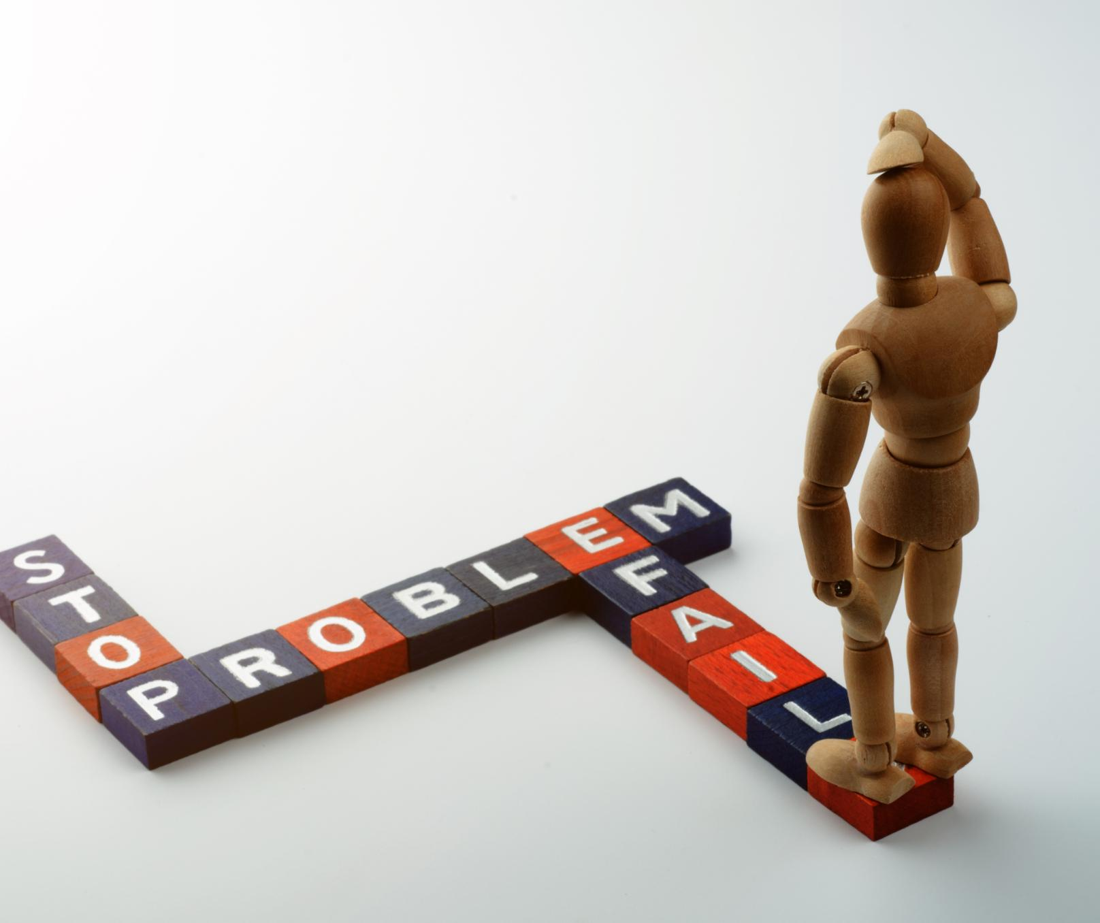
Using Variables in Word Problems
In word problems, variables can help us to set up equations to solve the problem.
We can use variables to represent unknown quantities in word problems.
We can then use algebraic expressions and equations to solve the problem.
Variables can help us to solve word problems more efficiently.
Notes:
Variables are also useful in solving word problems. We can use variables to represent unknown quantities in the problem, and then use algebraic expressions and equations to solve the problem. This helps us to solve word problems more efficiently.

Slide 8

Practice Makes Perfect
Now that you have learned about variables, it's time to practice!
Try solving some practice problems that involve variables.
Remember to always check your work and make sure your answer makes sense.
With more practice, you will become a master at using variables to solve problems!
Notes:
Now that you have learned about variables, it's time to put your skills to the test with some practice problems. Remember to always check your work and make sure your answer makes sense. With more practice, you will become a master at using variables to solve problems!

Slide 9

Practice

Slide 10

Answer

Slide 11

Practice

Slide 12

Answer

Slide 13
Writing Expressions with Variables
An expression is a combination of numbers, variables, and operations.
Variables can be used to represent unknown quantities in a problem.
When writing an expression, we use the variable to represent the unknown quantity and use the appropriate mathematical operation.
For example, if we want to find the total cost of buying x number of pencils that cost p dollars each, we can write the expression p*x.
Notes:
In this slide, we will learn how to write expressions to represent real-world problems using variables to represent numbers. An expression is a combination of numbers, variables, and operations. To write expressions, we use variables to represent unknown quantities in a problem. For example, if we want to find the total cost of buying x number of pencils that cost p dollars each, we can write the expression p*x. Let's look at some more examples.

Slide 14
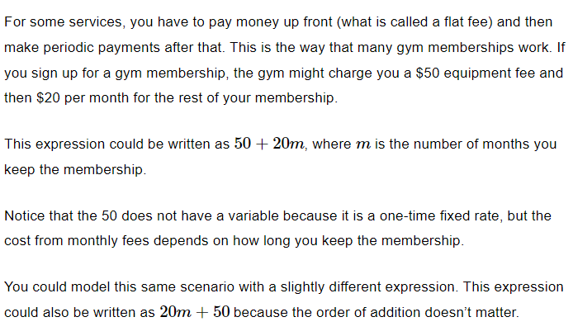
Example

Slide 15

Writing Expressions with Variables: Examples
Example 1: If we want to find the total cost of buying n tickets that cost t dollars each, we can write the expression t*n.
Example 2: If we want to find the area of a rectangle with length l and width w, we can write the expression l*w.
Example 3: If we want to find the distance traveled by a car moving at a speed of s miles per hour for t hours, we can write the expression s*t.
Notes:
In this slide, we will look at some examples to write expressions that represent real-world problems using variables to represent numbers. Example 1: If we want to find the total cost of buying n tickets that cost t dollars each, we can write the expression t*n. Example 2: If we want to find the area of a rectangle with length l and width w, we can write the expression l*w. Example 3: If we want to find the distance traveled by a car moving at a speed of s miles per hour for t hours, we can write the expression s*t. Remember that when writing expressions, we use variables to represent unknown quantities in a problem.

Slide 16
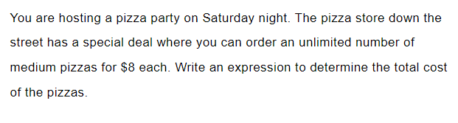
Practice

Slide 17

Answer

Slide 18
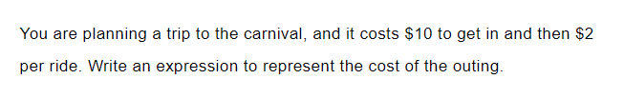
Practice

Slide 19

Answer

Slide 20
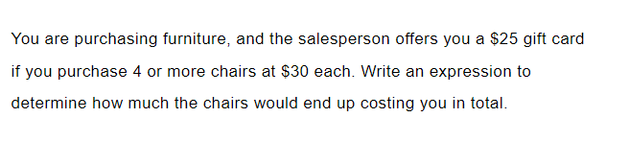
Practice
Practice

Slide 21

Answer

Slide 22
Key Points
Variables are symbols used to represent unknown quantities in equations and word problems.
A coefficient is a number that multiplies a variable.
Expressions are math sentences using numbers, operations, and variables.
Using variables in equations and word problems can help us to solve problems more efficiently and accurately.
Practice is key to mastering the use of variables.

